Slide 1

50.039 Theory and Practice of Deep Learning W11-S1 Introduction to Reinforcement Learning
Matthieu De Mari

Slide 2
About this week
What is Reinforcement Learning?
What are the key ideas behind reinforcement learning and its framework?
What is the exploration vs. exploitation tradeoff?
How do we train an RL agent by exploring, then progressively exploiting?
What are some advanced strategies in multi-arm bandit problems?
What are the Q and V functions for a RL problem?
What is Q-learning and how can it be implemented in RL problems?

Slide 3
About this week
What is Deep Q Learning? And which problem does it address?
What is RL with Human Feedback?
How to implement RLHF via the REINFORCE algorithm?
What are actor-critic learning methods? And which problems do these approaches address?
What are more advanced problems in RL?
Markov states
Partially observable environment
SARSA
Non-stationary problems

Slide 4
Reinforcement Learning, a definition
Definition (Reinforcement Learning - RL):
Reinforcement Learning (RL) is one of the many machine learning paradigms. Where DL attempts to learn from examples (i.e. samples in a dataset), RL attempts to train an AI from trial-and-error.
There is no dataset, only a feedback on the action taken in any given state.
This paradigm challenges the idea that computers and AIs should be learning from datasets.
What if the task at hand cannot be solved easily and no dataset can even be generated?
What if the dataset is flawed and does not contain the ground truth about the task?

Slide 5
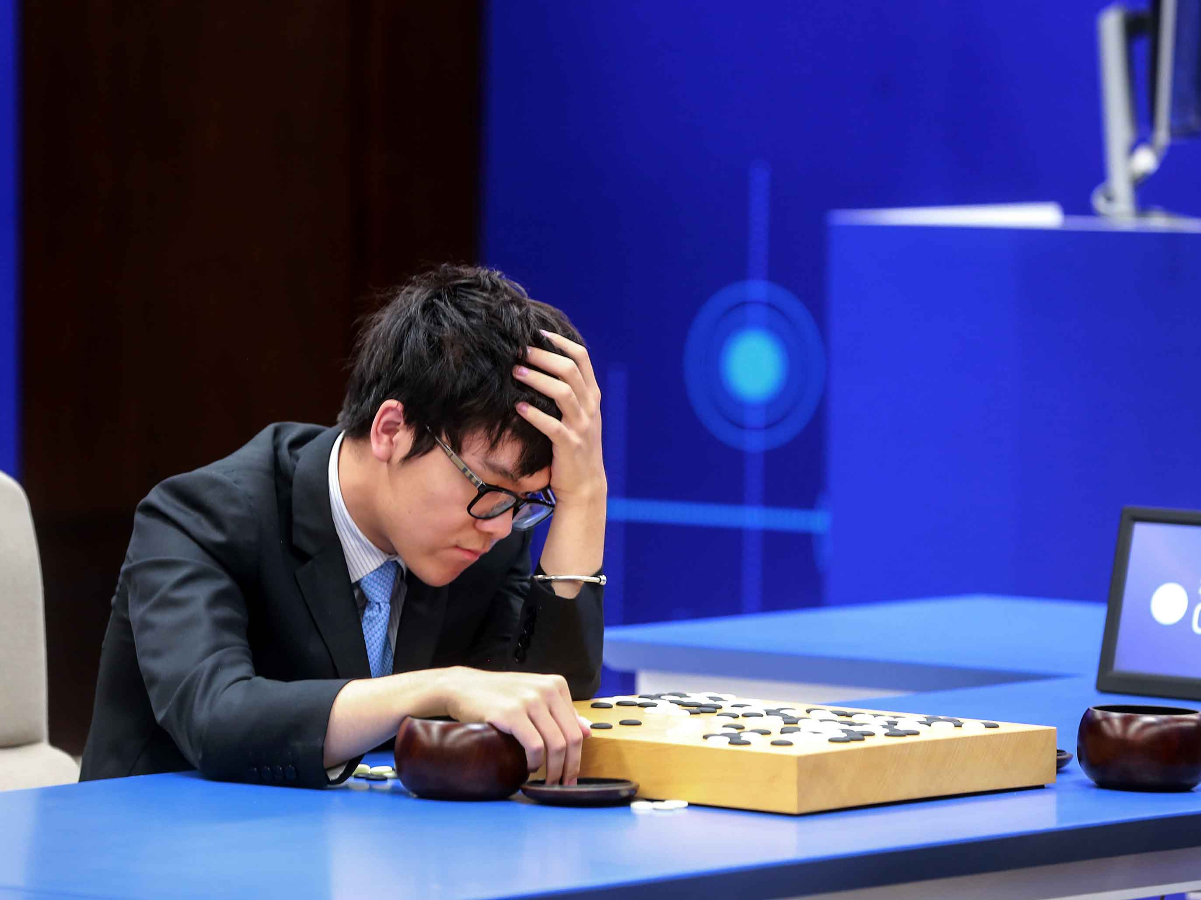
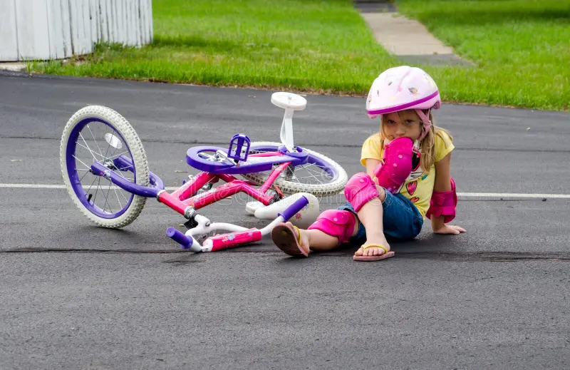
No datasets?
A Go AI would need to look at a board as input and produce the best move as an output.
However, Go is a prime example of a problem for which no dataset (board state → best action in given board state) can be generated.
This has to do with the fact that our understanding of the game of Go is actually… pretty bad.
How about riding a bike?

Slide 6
Reinforcement Learning
Definition (Reinforcement Learning - RL):
Reinforcement Learning (RL) is one of the many machine learning paradigms. Where Deep Learning (DL) attempts to learn from examples (i.e. datasets), RL attempts to learn from trial-and-error.
There is no dataset, only feedback on the action taken in a given state.
In RL, the AI learns by trying certain actions in given states and then receives a feedback (not always instantaneous) describing whether or not the action turned out to be a good or bad decision.
The AI then learns, on-the-fly, from trying out combination of (states, actions, feedback) for a given problem.

Slide 7
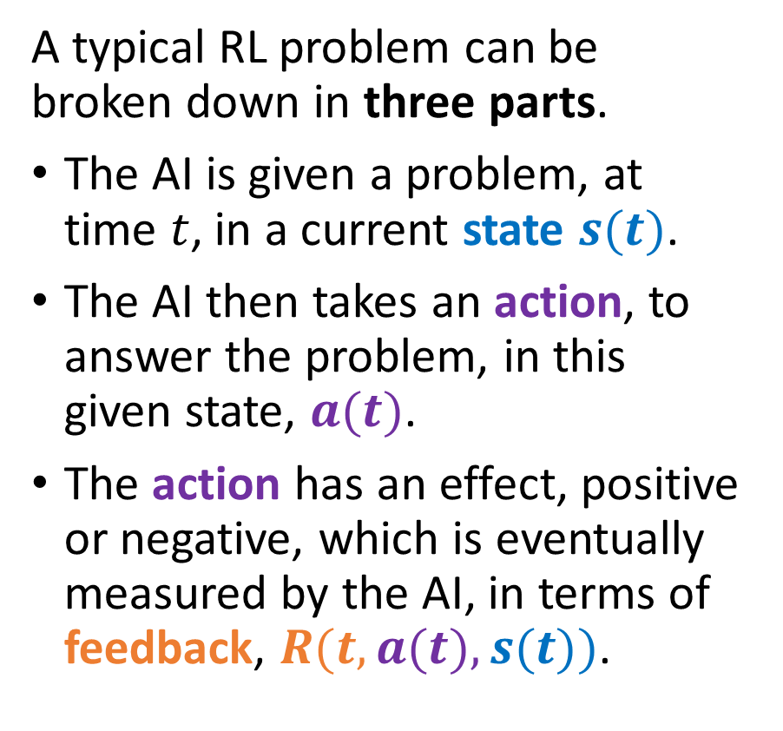
A typical RL problem
A typical RL problem can be broken down in three parts.
The AI is given a problem, at time $t$, in a current state $s(t)$.
The AI then takes an action, to answer the problem, in this given state, $a(t)$.
The action has an effect, positive or negative, which is eventually measured by the AI, in terms of feedback, $R(t, a(t), s(t))$.
State
Take action based on state
Reward is given for taking action in said state
Environment changes and a new state is produced

Slide 8
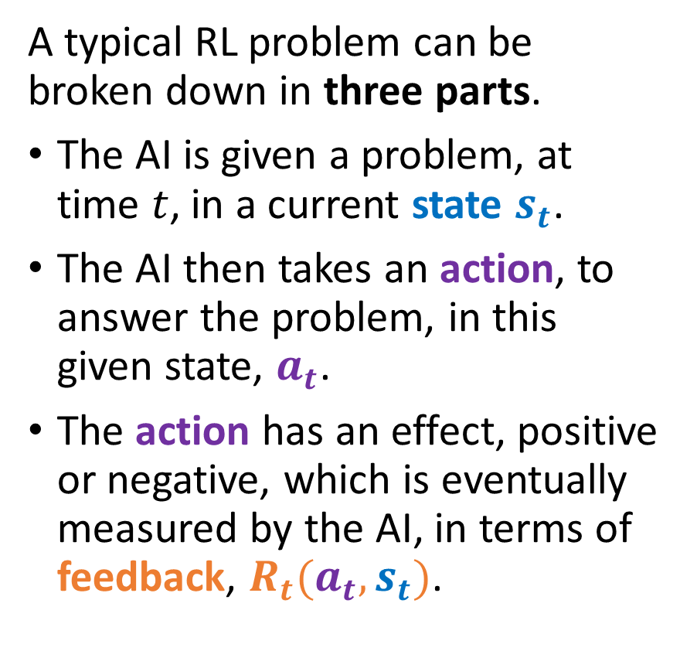
A typical RL problem
A typical RL problem can be broken down in three parts.
The AI is given a problem, at time $t$, in a current state $s_{t}$.
The AI then takes an action, to answer the problem, in this given state, $a_{t}$.
The action has an effect, positive or negative, which is eventually measured by the AI, in terms of feedback, $R_{t}(a_{t}, s_{t})$.
State
Take action based on state
Reward is given for taking action in said state
Environment changes and a new state is produced

Slide 9
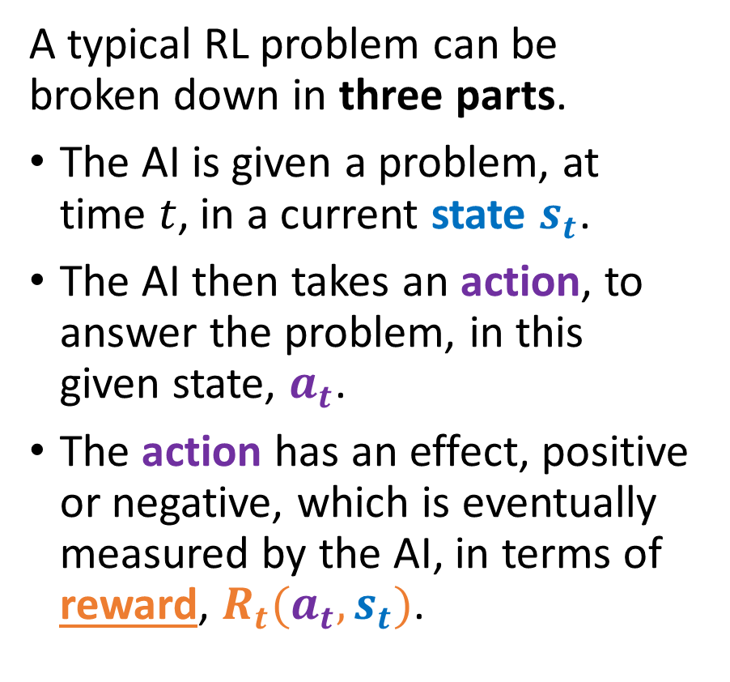
A typical RL problem
A typical RL problem can be broken down in three parts.
The AI is given a problem, at time $t$, in a current state $s_{t}$.
The AI then takes an action, to answer the problem, in this given state, $a_{t}$.
The action has an effect, positive or negative, which is eventually measured by the AI, in terms of reward, $R_{t}(a_{t}, s_{t})$.
State $s_{t}$
State 𝒔_𝒕
Take action based on state $a_{t}$
Take action based on state 𝒂_𝒕
Reward $R_{t}\left(a_{t}, s_{t}\right)$ is given for taking action in said state
Reward 𝑹_𝒕 (𝒂_𝒕, 𝒔_𝒕 ) is given for taking action in said state
Environment changes and a new state $s_{t+1}$ is produced
Environment changes and a new state 𝒔_(𝒕+𝟏) is produced

Slide 10
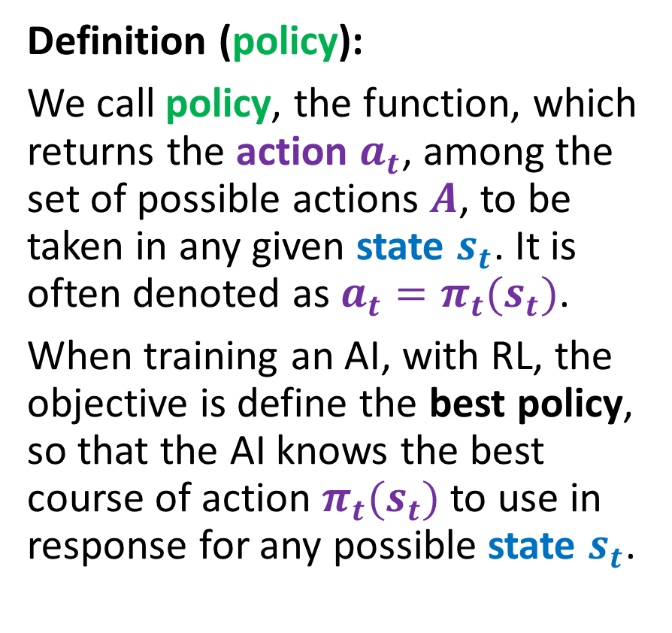
A typical RL problem
Definition (policy):
We call policy, the function, which returns the action $a_{t}$, among the set of possible actions $A$, to be taken in any given state $s_{t}$. It is often denoted as ${a_{t}=π}_{t}(s_{t})$.
When training an AI, with RL, the objective is define the best policy, so that the AI knows the best course of action $π_{t}(s_{t})$to use in response for any possible state $s_{t}$.
State $s_{t}$
State 𝒔_𝒕
Take action based on state ${a_{t}=π}_{t}(s_{t})$
Take action based on state 〖𝒂_𝒕=𝝅〗_𝒕 (𝒔_𝒕)
Reward $R_{t}\left(a_{t}, s_{t}\right)$ is given for taking action in said state
Reward 𝑹_𝒕 (𝒂_𝒕, 𝒔_𝒕 ) is given for taking action in said state
Environment changes and a new state $s_{t+1}$ is produced
Environment changes and a new state 𝒔_(𝒕+𝟏) is produced

Slide 11
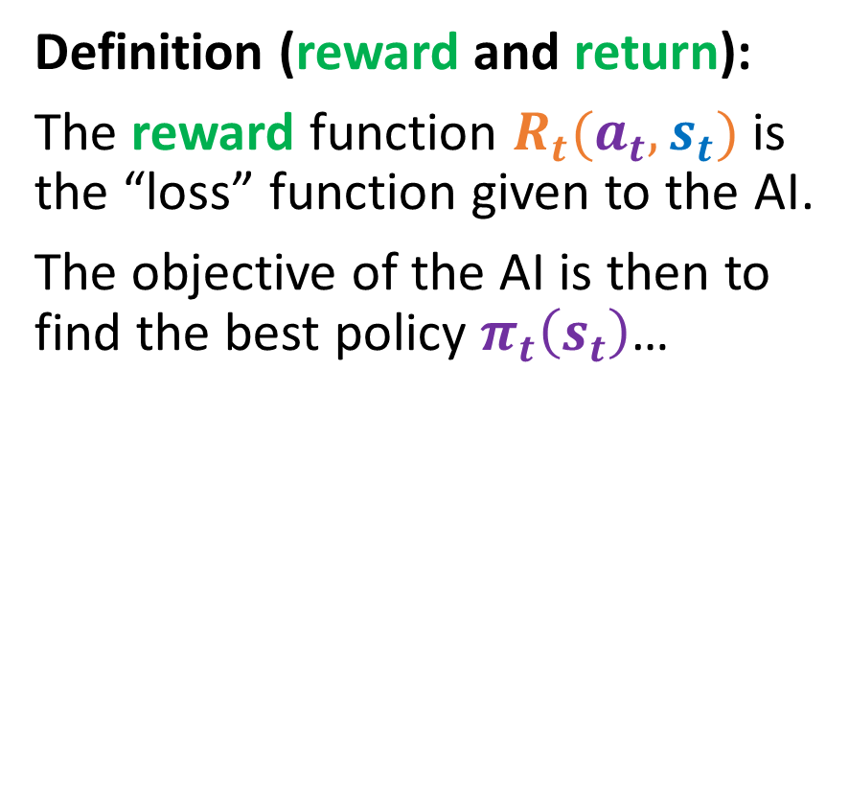
A typical RL problem
Definition (reward and return):
The reward function $R_{t}(a_{t}, s_{t})$ is the “loss” function given to the AI.
The objective of the AI is then to find the best policy $π_{t}\left(s_{t}\right)$…
State $s_{t}$
State 𝒔_𝒕
Take action based on state ${a_{t}=π}_{t}(s_{t})$
Take action based on state 〖𝒂_𝒕=𝝅〗_𝒕 (𝒔_𝒕)
Reward $R_{t}\left(a_{t}, s_{t}\right)$ is given for taking action in said state
Reward 𝑹_𝒕 (𝒂_𝒕, 𝒔_𝒕 ) is given for taking action in said state
Environment changes and a new state $s_{t+1}$ is produced
Environment changes and a new state 𝒔_(𝒕+𝟏) is produced

Slide 12
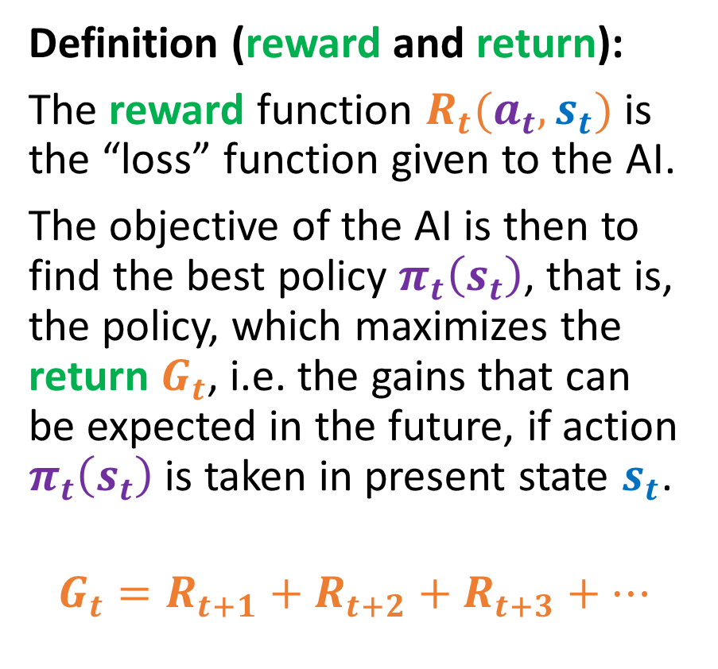
A typical RL problem
Definition (reward and return):
The reward function $R_{t}(a_{t}, s_{t})$ is the “loss” function given to the AI.
The objective of the AI is then to find the best policy $π_{t}\left(s_{t}\right)$, that is, the policy, which maximizes the return $G_{t}$, i.e. the gains that can be expected in the future, if action $π_{t}\left(s_{t}\right)$ is taken in present state $s_{t}$.
$$G_{t}=R_{t+1}+R_{t+2}+R_{t+3}+…$$
State $s_{t}$
State 𝒔_𝒕
Take action based on state ${a_{t}=π}_{t}(s_{t})$
Take action based on state 〖𝒂_𝒕=𝝅〗_𝒕 (𝒔_𝒕)
Reward $R_{t}\left(a_{t}, s_{t}\right)$ is given for taking action in said state
Reward 𝑹_𝒕 (𝒂_𝒕, 𝒔_𝒕 ) is given for taking action in said state
Environment changes and a new state $s_{t+1}$ is produced
Environment changes and a new state 𝒔_(𝒕+𝟏) is produced

Slide 13
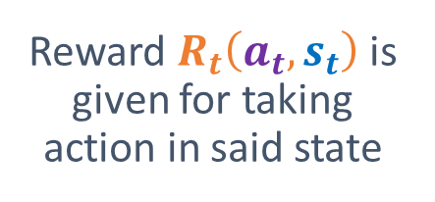
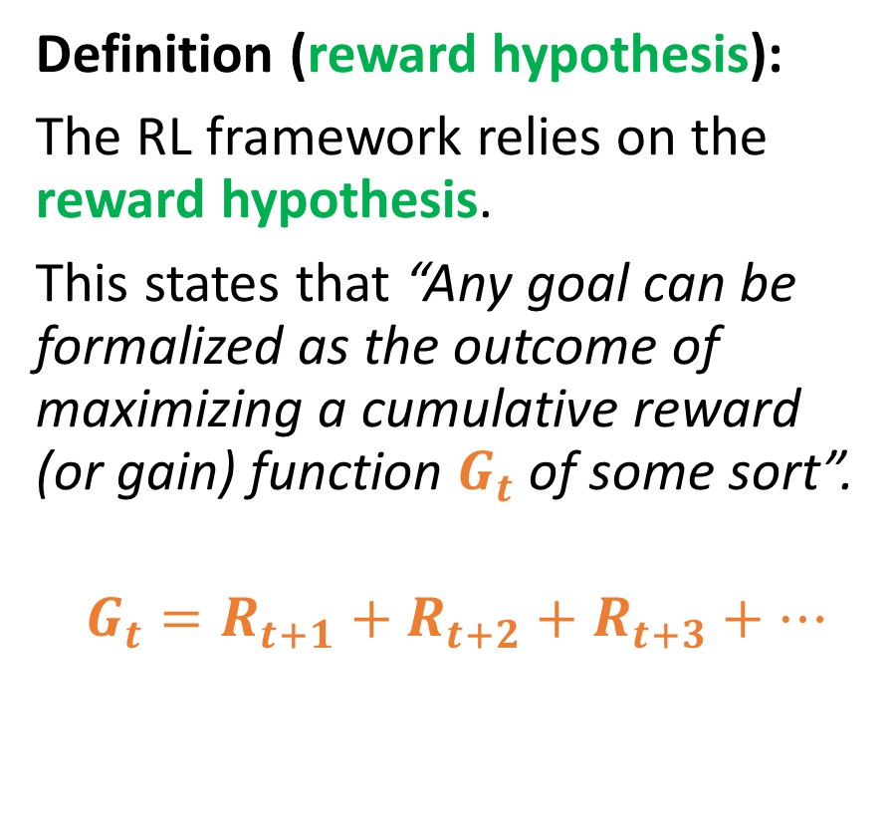
A typical RL problem
Definition (reward hypothesis):
The RL framework relies on the reward hypothesis.
This states that “Any goal can be formalized as the outcome of maximizing a cumulative reward (or gain) function $G_{t}$ of some sort”.
$$G_{t}=R_{t+1}+R_{t+2}+R_{t+3}+…$$
State $s_{t}$
State 𝒔_𝒕
Take action based on state ${a_{t}=π}_{t}(s_{t})$
Take action based on state 〖𝒂_𝒕=𝝅〗_𝒕 (𝒔_𝒕)
Reward $R_{t}\left(a_{t}, s_{t}\right)$ is given for taking action in said state
Reward 𝑹_𝒕 (𝒂_𝒕, 𝒔_𝒕 ) is given for taking action in said state
Environment changes and a new state $s_{t+1}$ is produced
Environment changes and a new state 𝒔_(𝒕+𝟏) is produced
Reward $R_{t}\left(a_{t}, s_{t}\right)$ is given for taking action in said state

Slide 14
A first toy problem
The Random Candy Machines problem

Slide 15
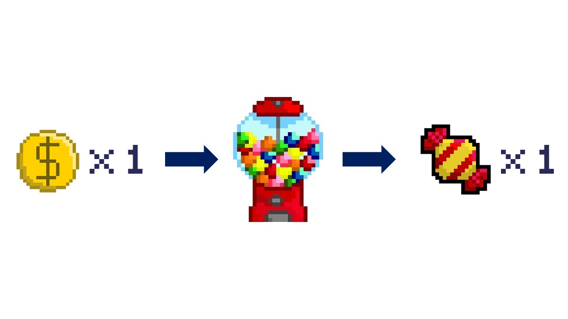
Candy Machines are deterministic
A standard candy machine often work as follows.
You put one coin in the machine and obtain a candy as a result.
Its behavior is deterministic, i.e. it is 100% predictable.
It will ALWAYS return a candy, whenever you put a coin in the machine.
(We also assume it never runs out of candy…)

Slide 16
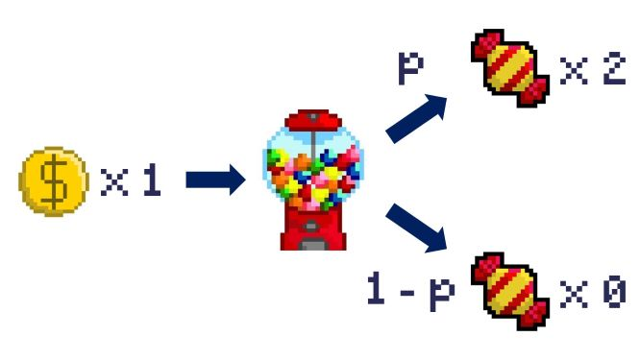
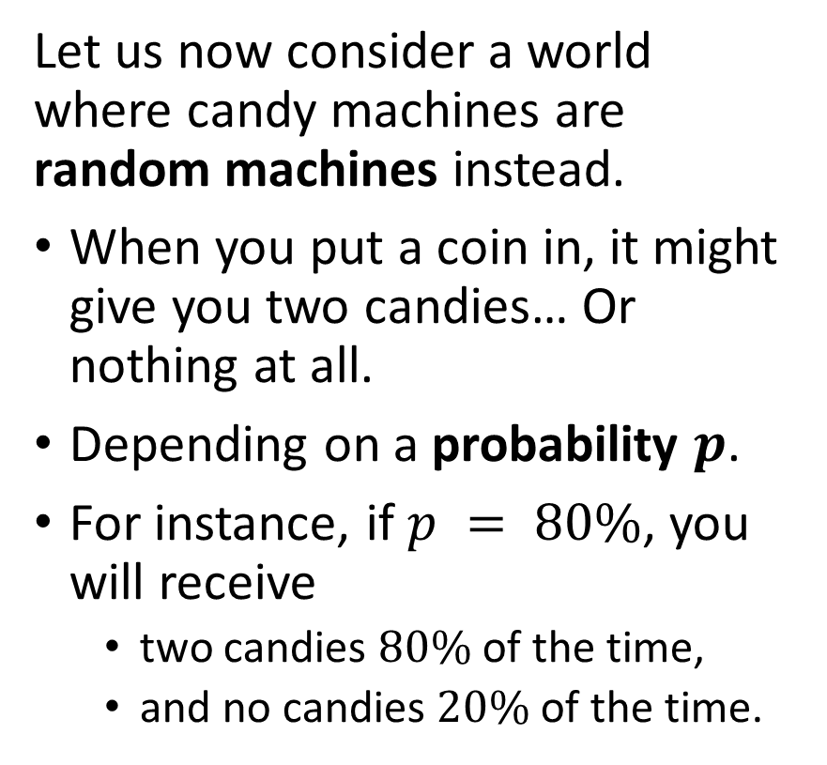
What if machines were random?
Let us now consider a world where candy machines are random machines instead.
When you put a coin in, it might give you two candies… Or nothing at all.
Depending on a probability $p$.
For instance, if $p = 80\%$, you will receive
two candies $80\%$of the time,
and no candies $20\%$ of the time.

Slide 17
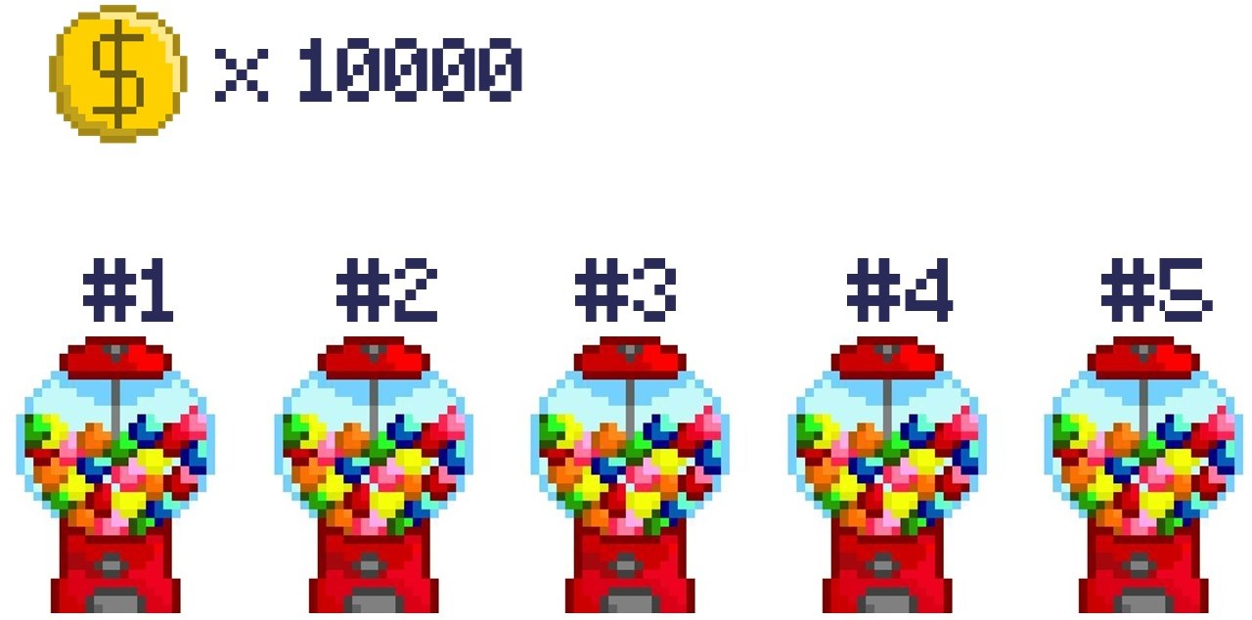
A simple problem?

Slide 18
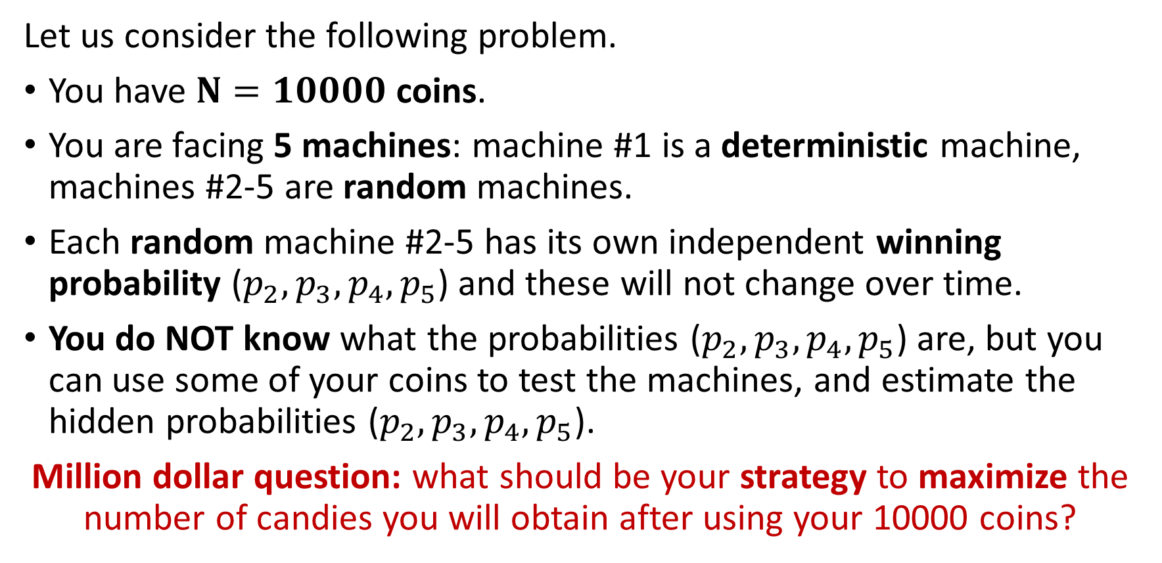
A simple problem?
Let us consider the following problem.
You have $N=10000$ coins.
You are facing 5 machines: machine #1 is a deterministic machine, machines #2-5 are random machines.
Each random machine #2-5 has its own independent winning probability ($p_{2}, p_{3},p_{4}, p_{5}$) and these will not change over time.
You do NOT know what the probabilities ($p_{2}, p_{3},p_{4}, p_{5}$) are, but you can use some of your coins to test the machines, and estimate the hidden probabilities ($p_{2}, p_{3},p_{4}, p_{5}$).
Million dollar question: what should be your strategy to maximize the number of candies you will obtain after using your 10000 coins?

Slide 19
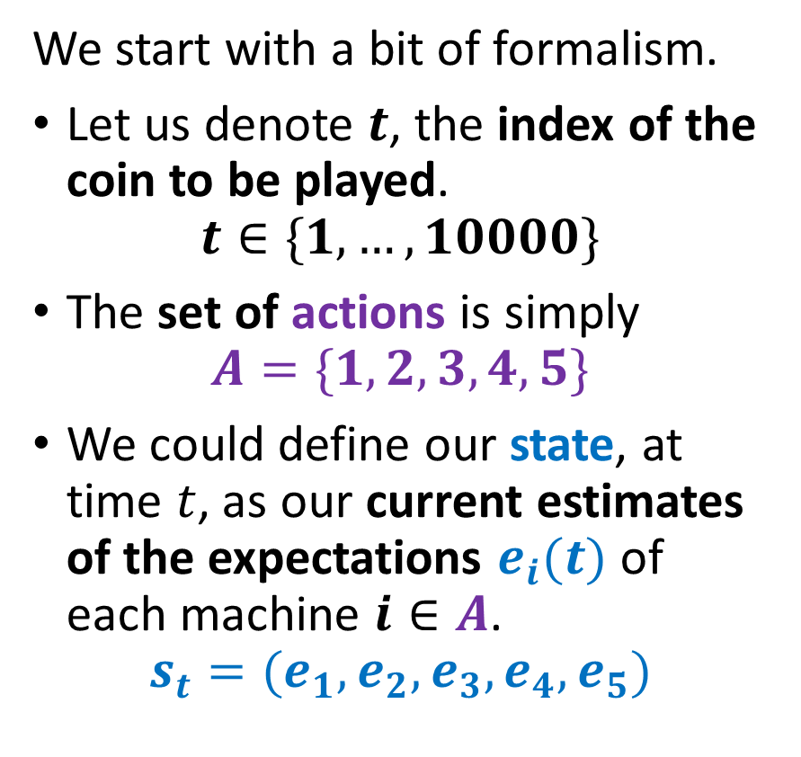
Reusing the RL formalism
We start with a bit of formalism.
Let us denote $t$, the index of the coin to be played.
$$t∈\{1, …, 10000\}$$
The set of actions is simply $A=\{1, 2, 3, 4, 5\}$
We could define our state, at time $t$, as our current estimates of the expectations $e_{i}(t)$ of each machine $i∈A$.
$$s_{t}=(e_{1}, e_{2}, e_{3}, e_{4}, e_{5})$$

Slide 20
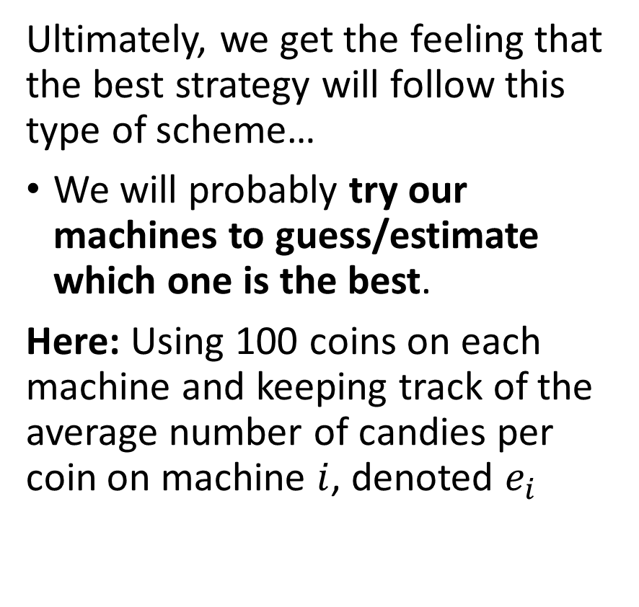
Reusing the RL formalism
Ultimately, we get the feeling that the best strategy will follow this type of scheme…
We will probably try our machines to guess/estimate which one is the best.
Here: Using 100 coins on each machine and keeping track of the average number of candies per coin on machine $i$, denoted $e_{i}$

Slide 21
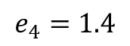
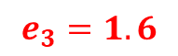
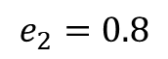
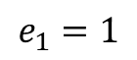
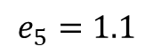
Reusing the RL formalism
Ultimately, we get the feeling that the best strategy will follow this type of scheme…
We will probably try our machines to guess/estimate which one is the best.
Here: Using 100 coins on each machine and keeping track of the average number of candies per coin on machine $i$, denoted $e_{i}$
$$e_{1}=1$$
$$e_{2}=0.8$$
$$e_{3}=1.6$$
$$e_{4}=1.4$$
$$e_{5}=1.1$$

Slide 22

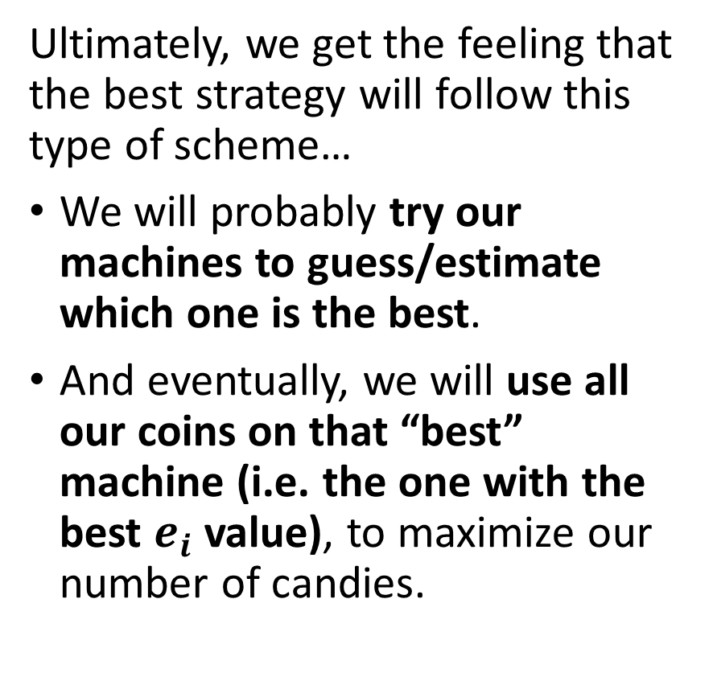
Reusing the RL formalism
Ultimately, we get the feeling that the best strategy will follow this type of scheme…
We will probably try our machines to guess/estimate which one is the best.
And eventually, we will use all our coins on that “best” machine (i.e. the one with the best $e_{i}$ value), to maximize our number of candies.

Slide 23
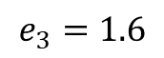
Exploration and exploitation tradeoff
Definition (exploration and exploitation):
The phase during which, you try out possible actions, even though they might not be optimal, in order to acquire knowledge about the problem is called exploration.
$$e_{1}=1$$
$$e_{2}=0.8$$
$$e_{3}=1.6$$
$$e_{4}=1.4$$
$$e_{5}=1.1$$

Slide 24
Exploration and exploitation tradeoff
Definition (exploration and exploitation):
The phase during which, you try out possible actions, even though they might not be optimal, in order to acquire knowledge about the problem is called exploration.
The second phase, where you rely on your acquired knowledge, and play what you feel is the best strategy, is called exploitation.

Slide 25
Exploration and exploitation tradeoff
Definition (exploration vs. exploitation tradeoff):
A good RL-based AI, needs to smartly combine exploration and exploitation phases.

Slide 26
Exploration and exploitation tradeoff
Definition (exploration vs. exploitation tradeoff):
A good RL-based AI, needs to smartly combine exploration and exploitation phases.
Too much exploration? You have wasted coins trying out bad machines.

Slide 27
Exploration and exploitation tradeoff
Definition (exploration vs. exploitation tradeoff):
A good RL-based AI, needs to smartly combine exploration and exploitation phases.
Too much exploration? You have wasted coins trying out bad machines.

Slide 28
Exploration and exploitation tradeoff
Definition (exploration vs. exploitation tradeoff):
A good RL-based AI, needs to smartly combine exploration and exploitation phases.
Too much exploration? You have wasted coins trying out bad machines.
No enough exploration? You might end up choosing the wrong machine as the “best” one.

Slide 29
Exploration and exploitation tradeoff
Exploration
Exploitation
Definition (exploration vs. exploitation tradeoff):
A good RL-based AI, needs to smartly combine exploration and exploitation phases.
Too much exploration? You have wasted coins trying out bad machines.
No enough exploration? You might end up choosing the wrong machine as the “best” one.

Slide 30
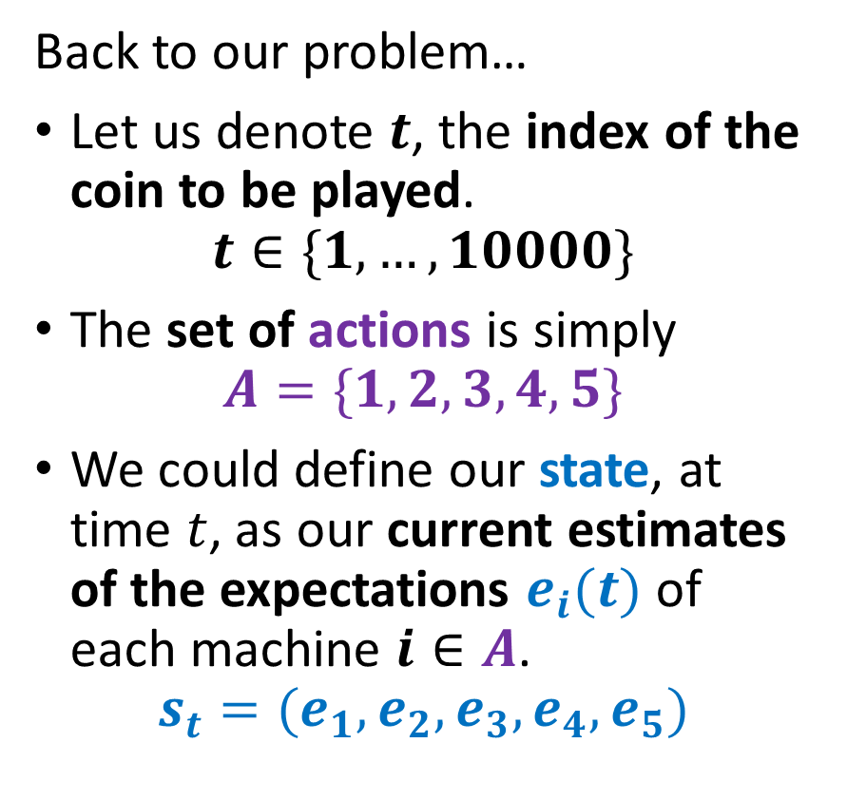
Reusing the RL formalism
Back to our problem…
Let us denote $t$, the index of the coin to be played.
$$t∈\{1, …, 10000\}$$
The set of actions is simply $A=\{1, 2, 3, 4, 5\}$
We could define our state, at time $t$, as our current estimates of the expectations $e_{i}(t)$ of each machine $i∈A$.
$$s_{t}=(e_{1}, e_{2}, e_{3}, e_{4}, e_{5})$$

Slide 31
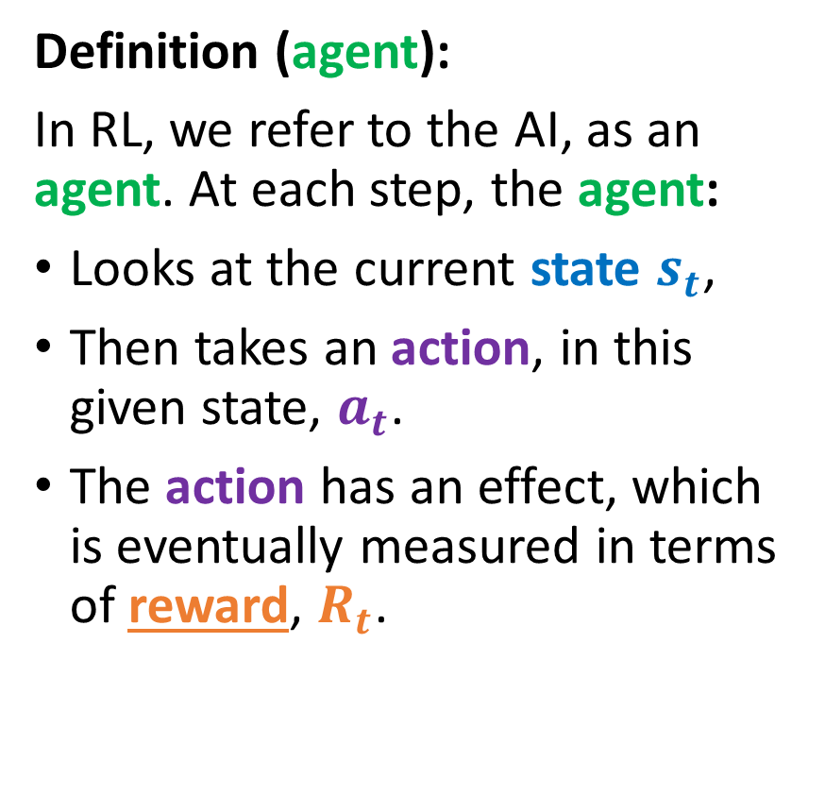
Reusing the RL formalism
State $s_{t}$
State 𝒔_𝒕
Take action based on state $a_{t}$
Take action based on state 𝒂_𝒕
Reward $R_{t}\left(a_{t}, s_{t}\right)$ is given for taking action in said state
Reward 𝑹_𝒕 (𝒂_𝒕, 𝒔_𝒕 ) is given for taking action in said state
Environment changes and a new state $s_{t+1}$ is produced
Environment changes and a new state 𝒔_(𝒕+𝟏) is produced
Definition (agent):
In RL, we refer to the AI, as an agent. At each step, the agent:
Looks at the current state $s_{t}$,
Then takes an action, in this given state, $a_{t}$.
The action has an effect, which is eventually measured in terms of reward, $R_{t}$.

Slide 32
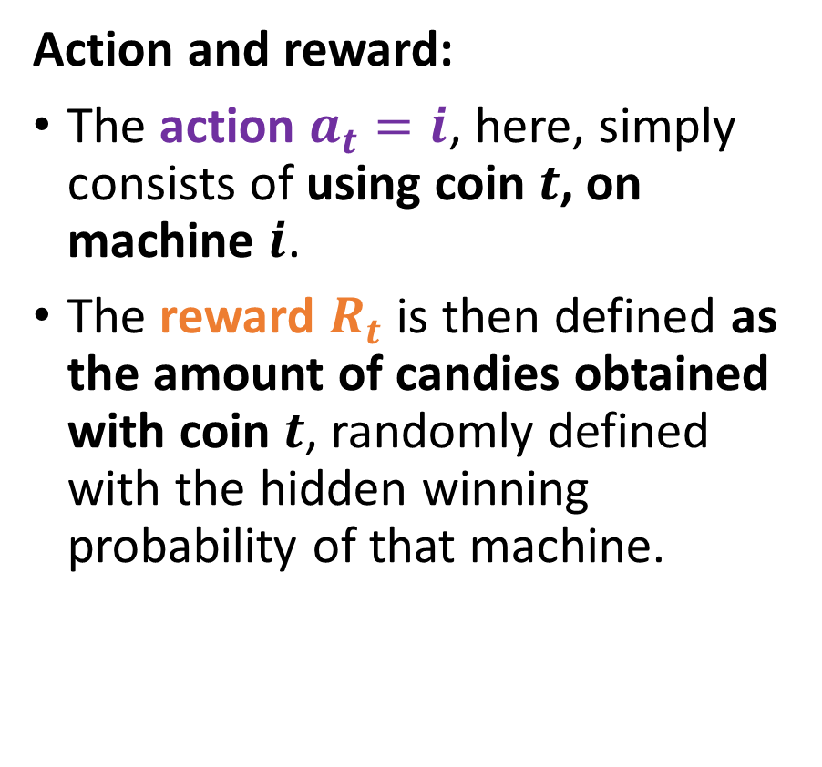
Reusing the RL formalism
State $s_{t}$
State 𝒔_𝒕
Take action based on state $a_{t}$
Take action based on state 𝒂_𝒕
Reward $R_{t}\left(a_{t}, s_{t}\right)$ is given for taking action in said state
Reward 𝑹_𝒕 (𝒂_𝒕, 𝒔_𝒕 ) is given for taking action in said state
Environment changes and a new state $s_{t+1}$ is produced
Environment changes and a new state 𝒔_(𝒕+𝟏) is produced
Action and reward:
The action $a_{t}=i$, here, simply consists of using coin $t$, on machine $i$.
The reward $R_{t}$ is then defined as the amount of candies obtained with coin $t$, randomly defined with the hidden winning probability of that machine.

Slide 33
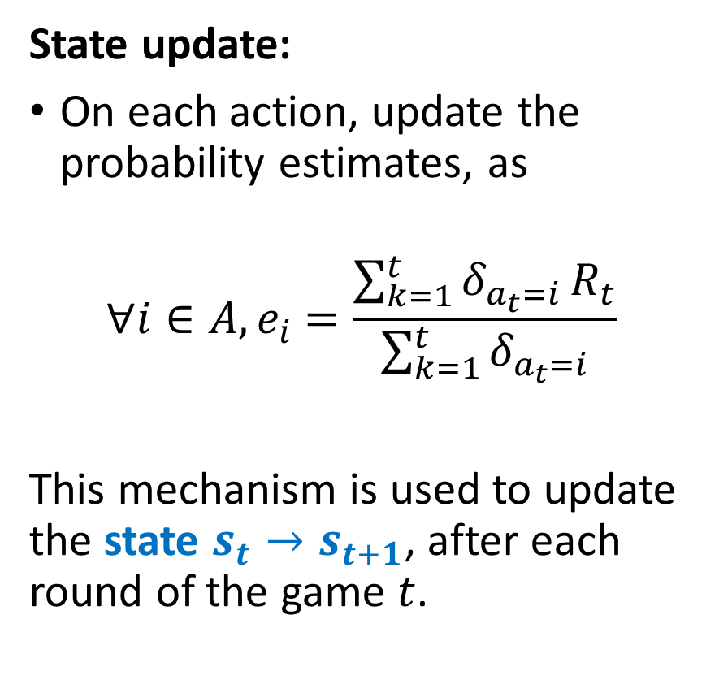
Reusing the RL formalism
State $s_{t}$
State 𝒔_𝒕
Take action based on state $a_{t}$
Take action based on state 𝒂_𝒕
Reward $R_{t}\left(a_{t}, s_{t}\right)$ is given for taking action in said state
Reward 𝑹_𝒕 (𝒂_𝒕, 𝒔_𝒕 ) is given for taking action in said state
Environment changes and a new state $s_{t+1}$ is produced
Environment changes and a new state 𝒔_(𝒕+𝟏) is produced
State update:
On each action, update the probability estimates, as
$${∀i∈A, e}_{i} =\frac{\sum_{k=1}^{t}{δ_{a_{t}=i}}R_{t}}{\sum_{k=1}^{t}{δ_{a_{t}=i}}}$$
This mechanism is used to update the state $s_{t}→s_{t+1}$, after each round of the game $t$.

Slide 34
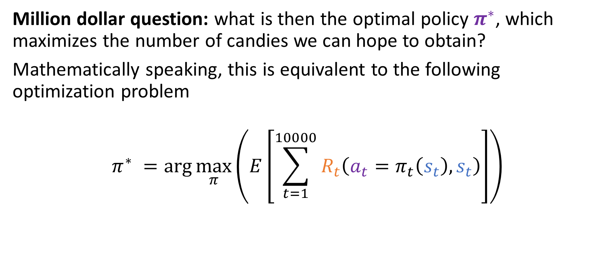
Reusing the RL formalism
Million dollar question: what is then the optimal policy $π^{∗}$, which maximizes the number of candies we can hope to obtain?
Mathematically speaking, this is equivalent to the following optimization problem
$$π^{∗} =\arg{\max_{π}\left(E\left[\sum_{t=1}^{10000}{R_{t}\left(a_{t}=π_{t}\left(s_{t}\right), s_{t}\right)}\right]\right)}$$

Slide 35
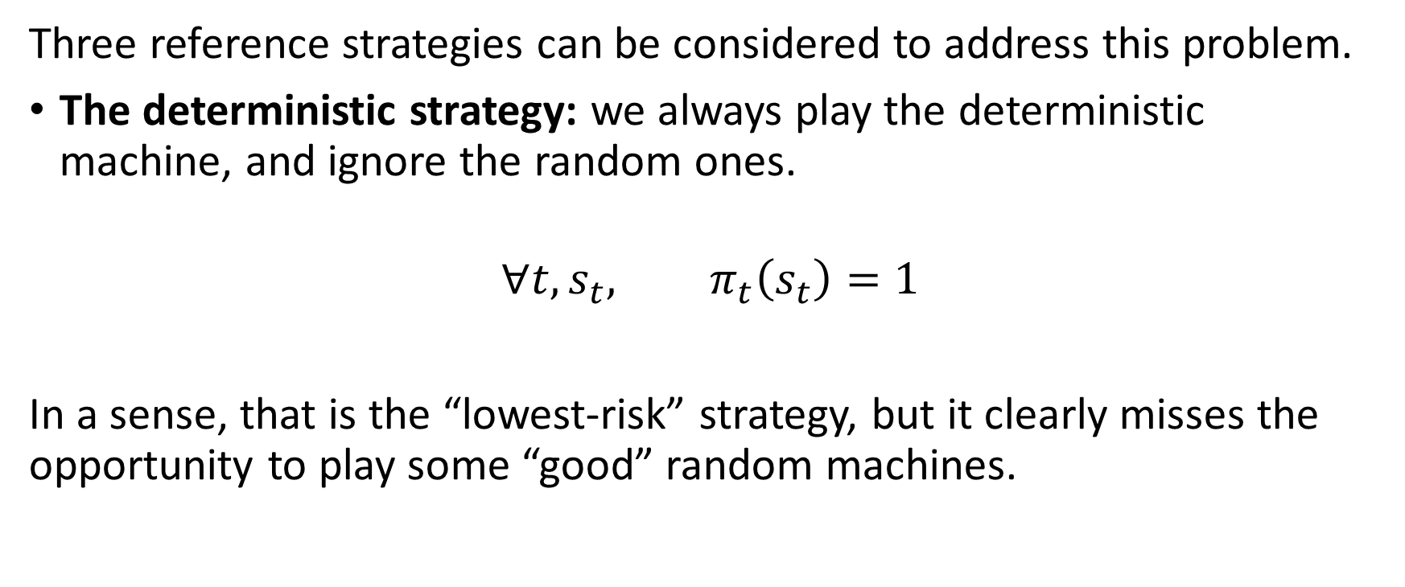
Starting with three reference strategies
Three reference strategies can be considered to address this problem.
The deterministic strategy: we always play the deterministic machine, and ignore the random ones.
$$∀t, s_{t}, π_{t}\left(s_{t}\right)=1$$
In a sense, that is the “lowest-risk” strategy, but it clearly misses the opportunity to play some “good” random machines.

Slide 36
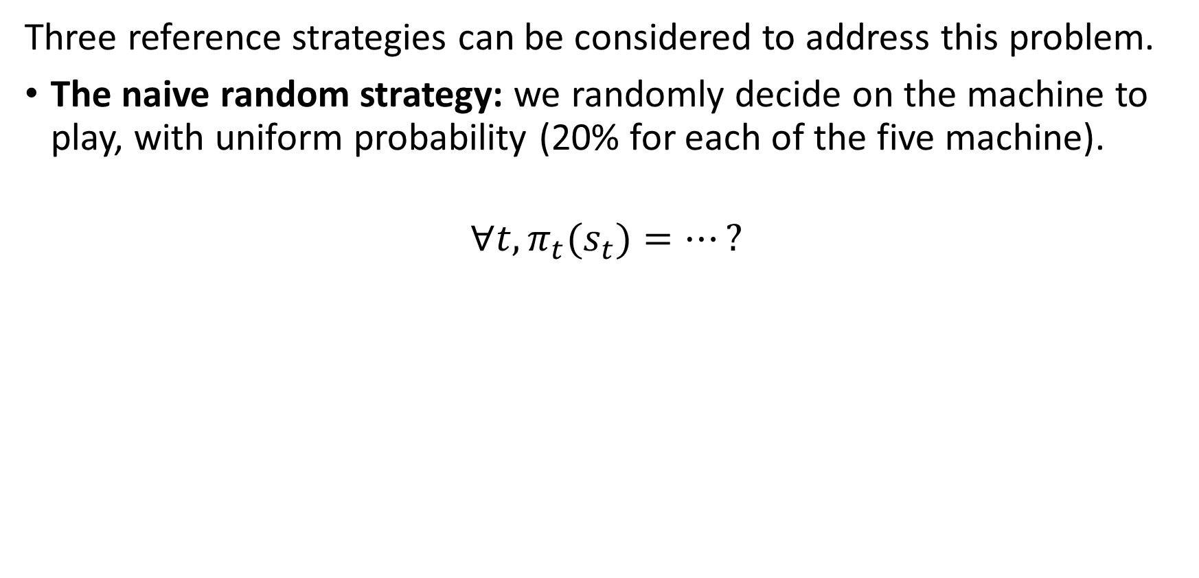
Starting with three reference strategies
Three reference strategies can be considered to address this problem.
The naive random strategy: we randomly decide on the machine to play, with uniform probability (20% for each of the five machine).
$$∀t, π_{t}(s_{t})=…?$$

Slide 37
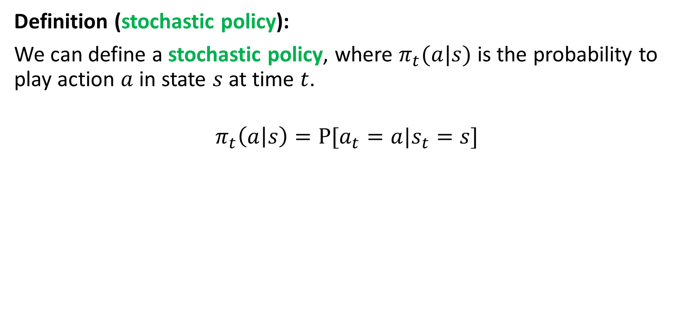
Starting with three reference strategies
Definition (stochastic policy):
We can define a stochastic policy, where $π_{t}(a|s)$ is the probability to play action $a$ in state $s$ at time $t$.
$$π_{t}\left(a | s\right)=Ρ[a_{t}=a|s_{t}=s]$$

Slide 38
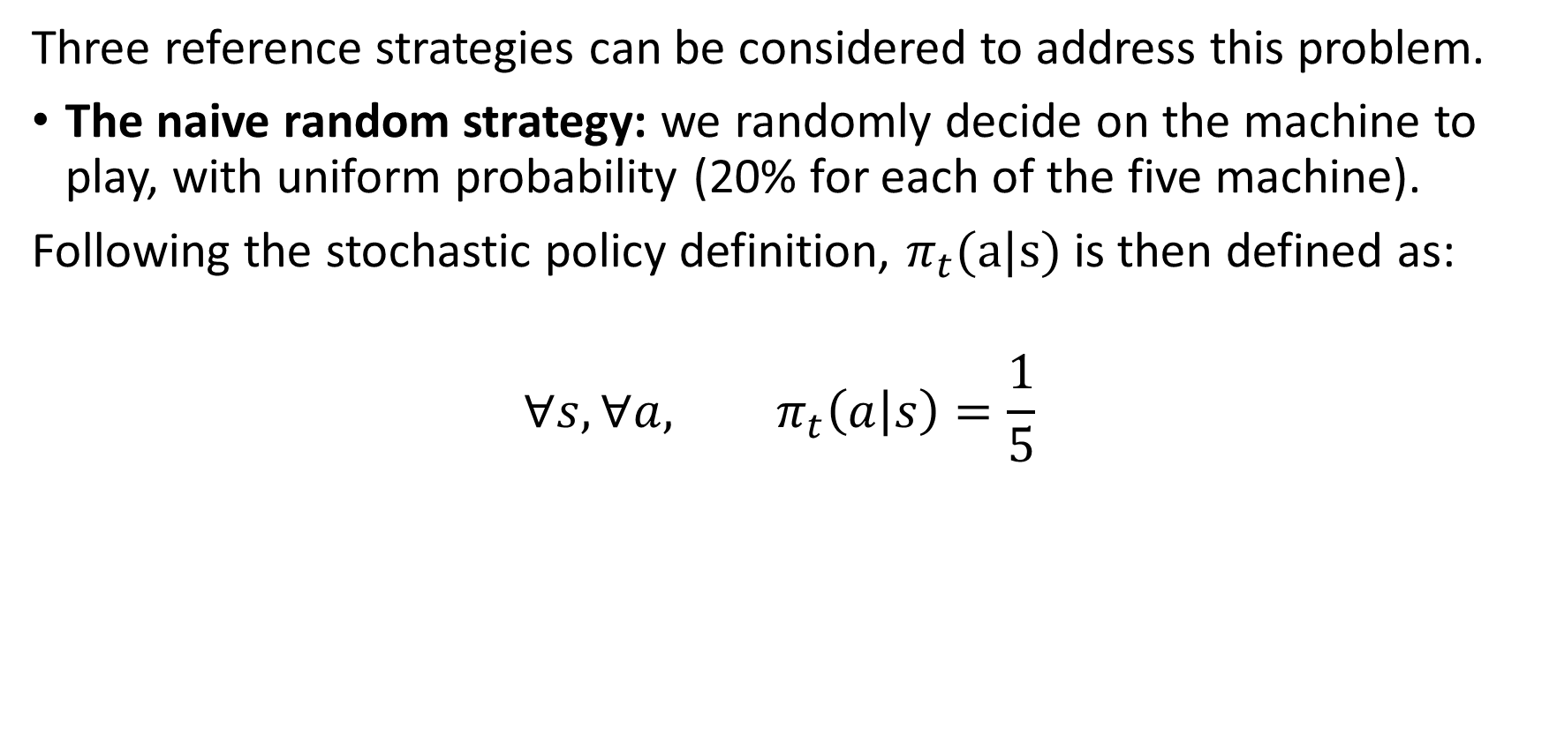
Starting with three reference strategies
Three reference strategies can be considered to address this problem.
The naive random strategy: we randomly decide on the machine to play, with uniform probability (20% for each of the five machine).
Following the stochastic policy definition, $π_{t}(a|s)$ is then defined as:
$${∀s, ∀a, π}_{t}\left(a | s\right)=\frac{1}{5}$$

Slide 39
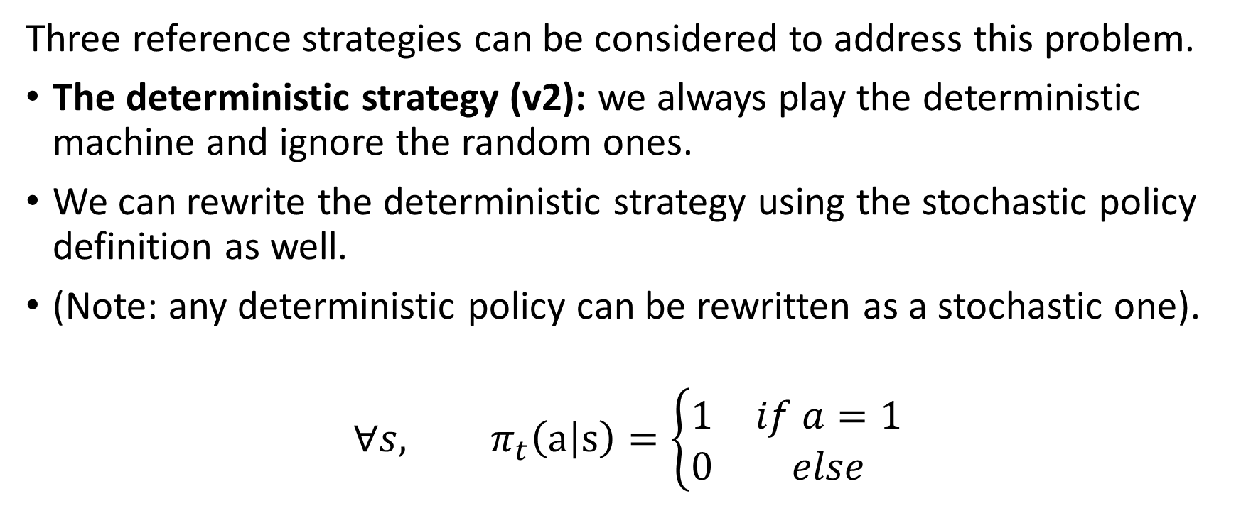
Starting with three reference strategies
Three reference strategies can be considered to address this problem.
The deterministic strategy (v2): we always play the deterministic machine and ignore the random ones.
We can rewrite the deterministic strategy using the stochastic policy definition as well.
(Note: any deterministic policy can be rewritten as a stochastic one).
$${∀s, π}_{t}\left(a | s\right)=\left\{\begin{matrix}1 & if a=1 \\ 0 & else\end{matrix}\right.$$

Slide 40
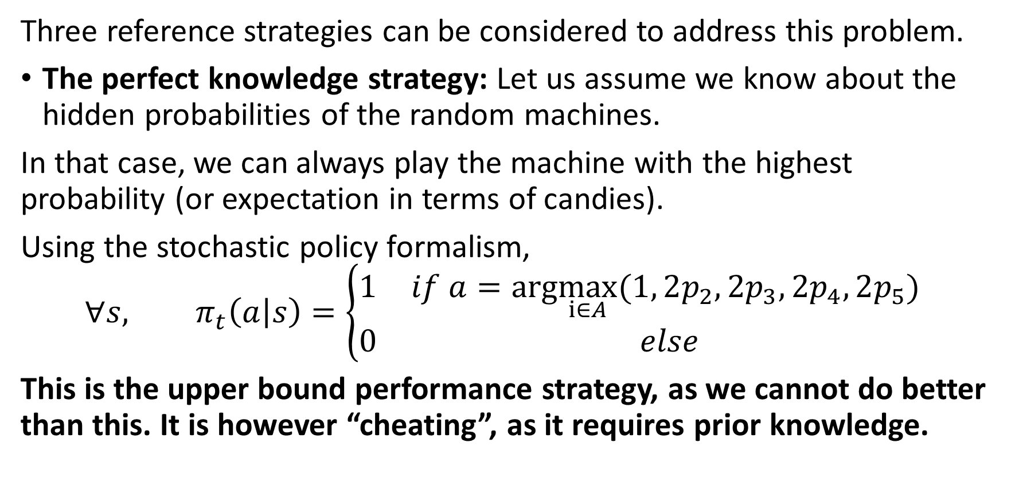
Starting with three reference strategies
Three reference strategies can be considered to address this problem.
The perfect knowledge strategy: Let us assume we know about the hidden probabilities of the random machines.
In that case, we can always play the machine with the highest probability (or expectation in terms of candies).
Using the stochastic policy formalism,
$${∀s, π}_{t}\left(a | s\right)=\left\{\begin{matrix}1 & if a=arg\max_{i∈A}(1, 2p_{2},2p_{3},2p_{4},2p_{5}) \\ 0 & else\end{matrix}\right.$$
This is the upper bound performance strategy, as we cannot do better than this. It is however “cheating”, as it requires prior knowledge.

Slide 41
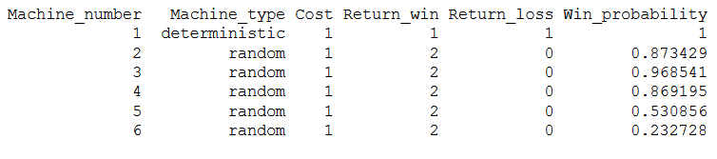
Performance of reference strategies
Consider the following game, which includes six machines (one deterministic and five random machines), with parameters shown below.
The best machine to play is obviously machine 3, here.

Slide 42
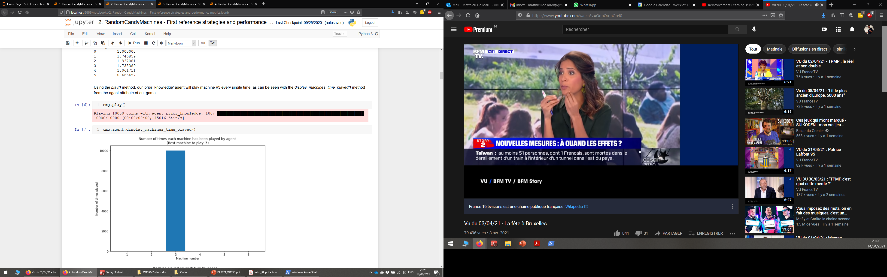
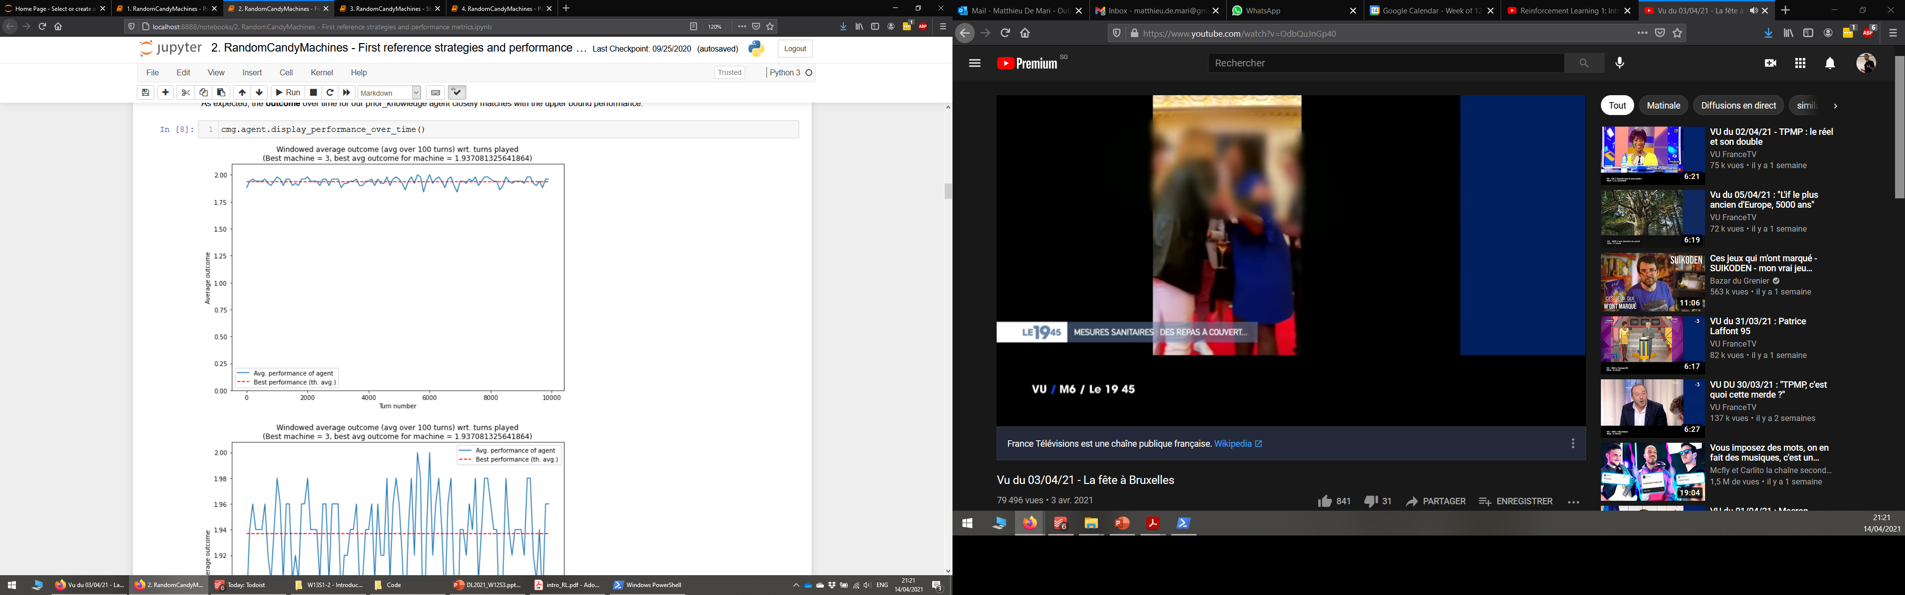
Performance of reference strategies
As expected, the perfect knowledge strategy then always plays machine 3.
It defines the theoretical upper bound for all strategies, i.e. the maximal number of candies one can hope to obtain.
Unfortunately, the perfect knowledge strategy assumes it knows the hidden probabilities.
All other strategies will not have access to such knowledge!

Slide 43
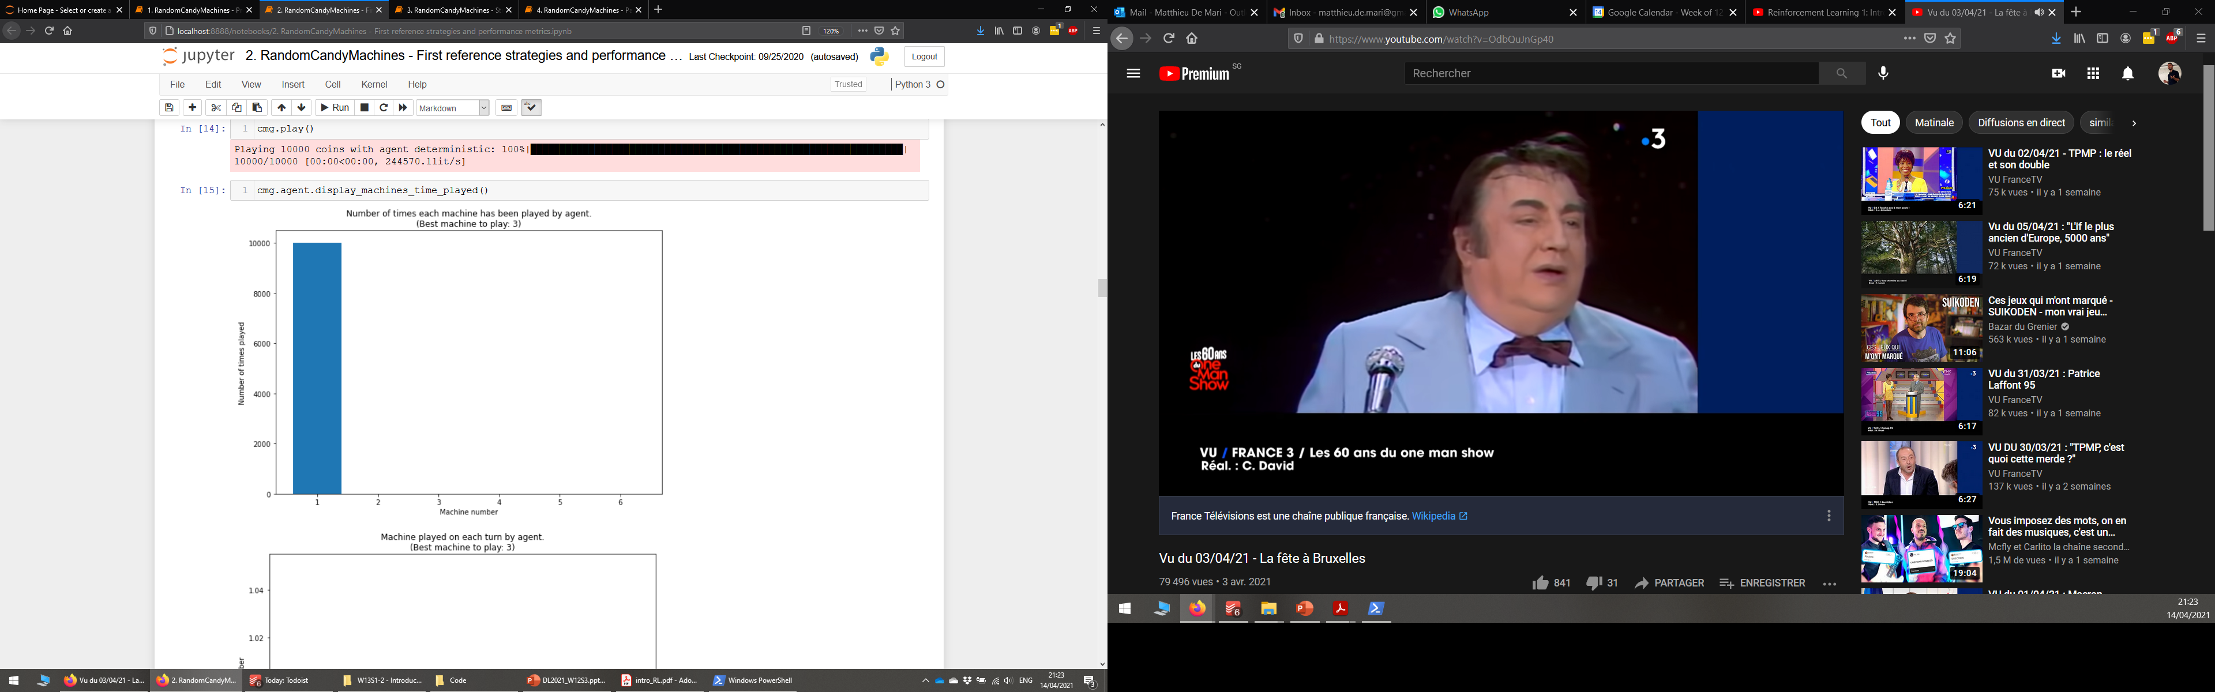
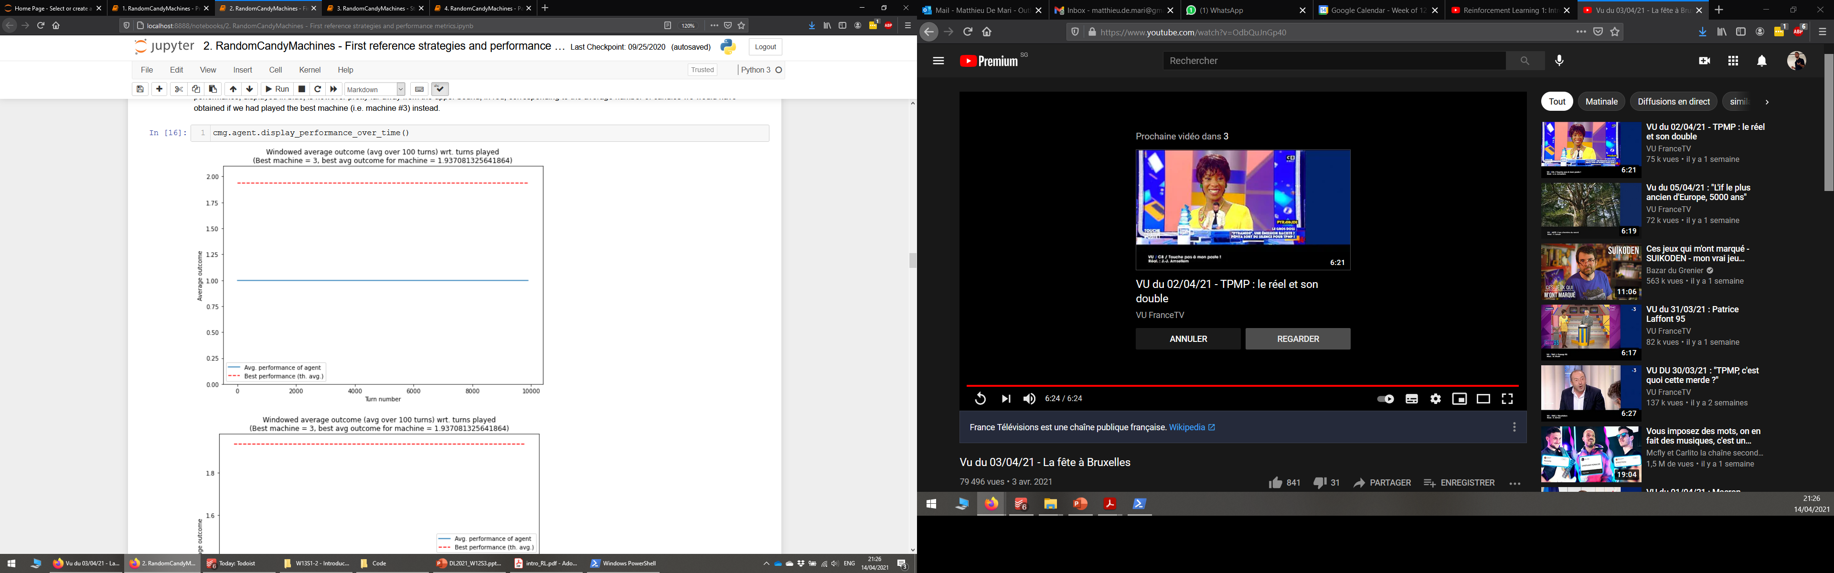
Performance of reference strategies
As expected, the deterministic strategy always plays on machine 1.
Its performance is very low compared to the perfect knowledge one.
Because, it misses on the opportunity of winning more candies by playing some random machines, with higher yield.
It defines a lower bound for the performance.

Slide 44
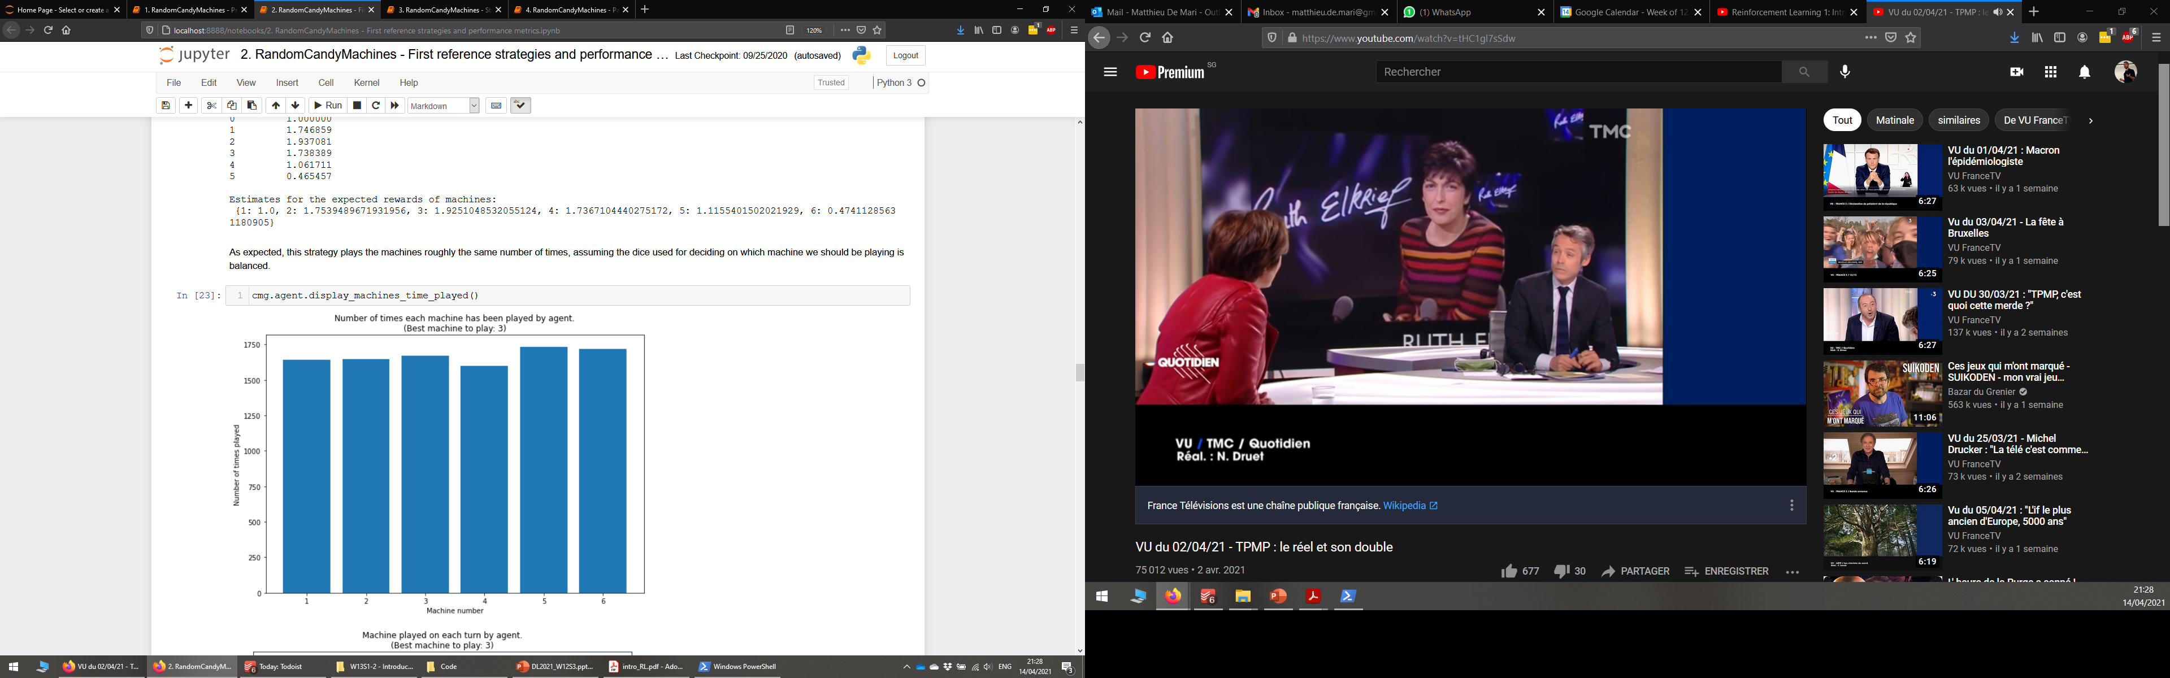
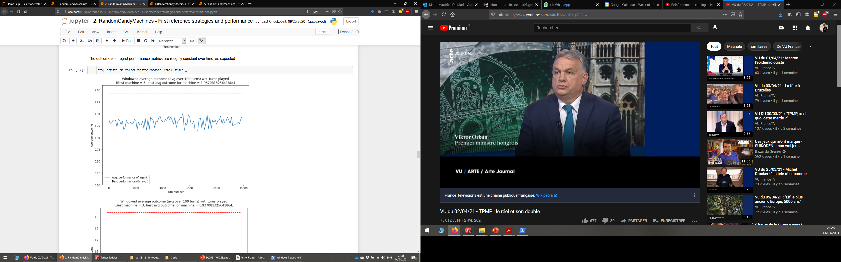
Performance of reference strategies
The naive random strategy, on the other hand, plays all six machines, roughly the same number of times.
Note: it performs slightly better than the deterministic one. But this is due to the fact that the random machines were - on that particular run - initialized with probabilities/yields roughly better than the deterministic one.

Slide 45
Performance of reference strategies
The naive random strategy, on the other hand, plays all six machines, roughly the same number of times.
Note: it performs slightly better than the deterministic one. But this is due to the fact that the random machines were - on that particular run - initialized with probabilities/yields roughly better than the deterministic one.

Slide 46
Performance of reference strategies
Overall, our deterministic and basic random strategies struggle because
The deterministic one refuses to explore before exploiting, as it plays it “safe”, using the deterministic machine only.
The naive random strategy explores all machines but is unable to exploit any knowledge it might obtain from the exploration.
They both miss the opportunity to play the best random machine, which might have better performance.
More advanced strategies will have to combine exploration and exploitation in an intelligent manner.

Slide 47
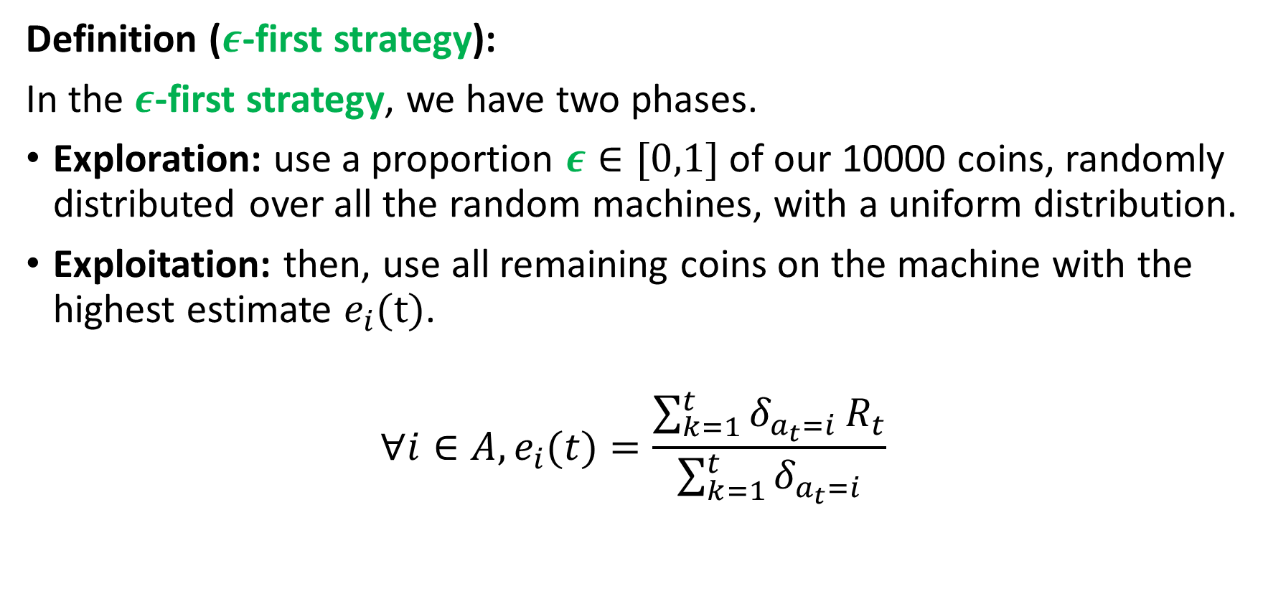
Exploring and exploiting (strategy #1)
Definition ($ε$-first strategy):
In the $ε$-first strategy, we have two phases.
Exploration: use a proportion $ε∈[0,1]$ of our 10000 coins, randomly distributed over all the random machines, with a uniform distribution.
Exploitation: then, use all remaining coins on the machine with the highest estimate $e_{i}(t)$.
$${∀i∈A, e}_{i}(t)=\frac{\sum_{k=1}^{t}{δ_{a_{t}=i}}R_{t}}{\sum_{k=1}^{t}{δ_{a_{t}=i}}}$$

Slide 48
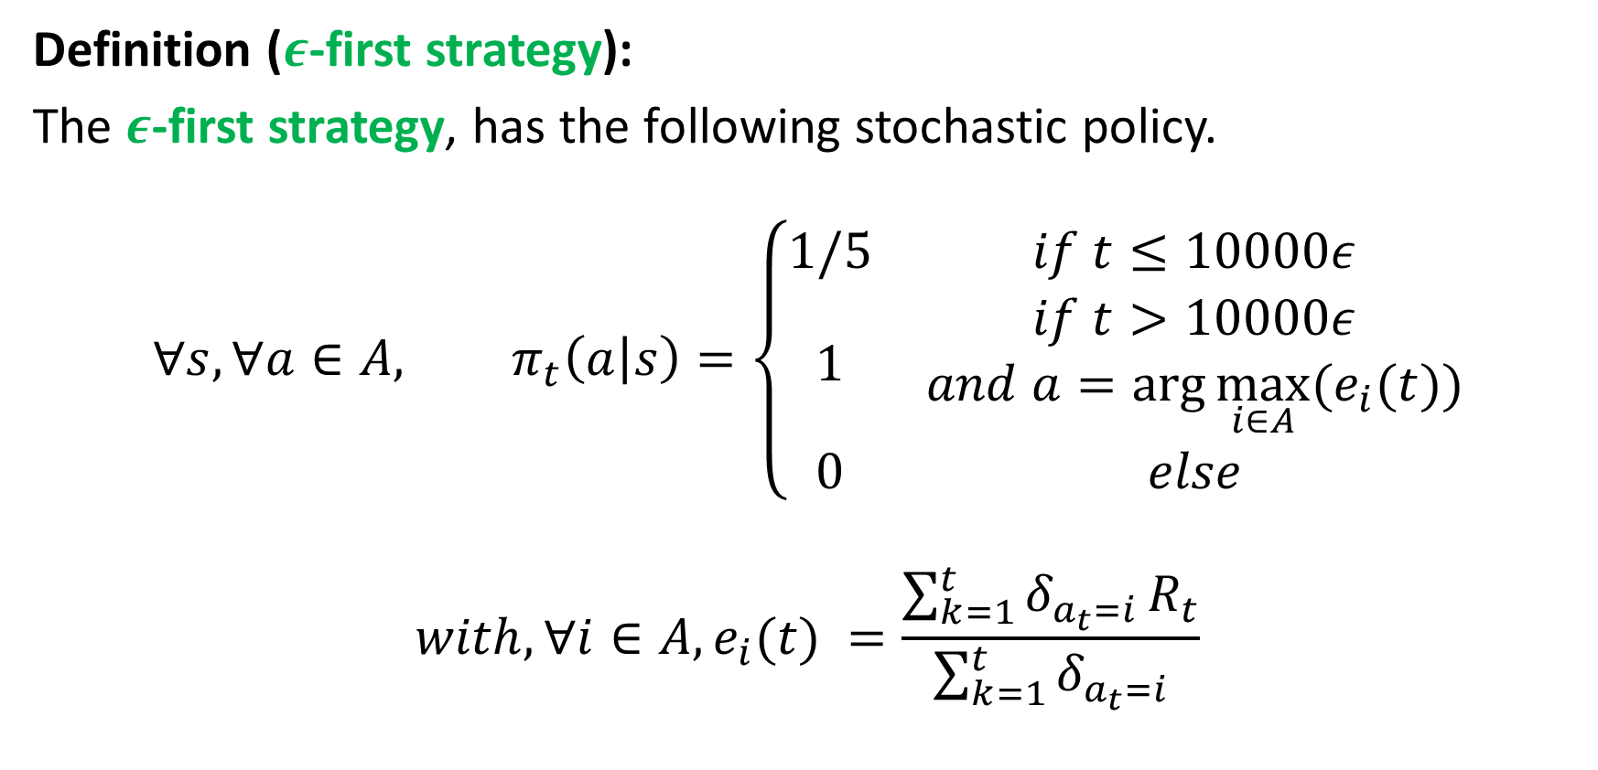
Exploring and exploiting (strategy #1)
Definition ($ε$-first strategy):
The $ε$-first strategy, has the following stochastic policy.
$$∀s, ∀a∈A, π_{t}\left(a | s\right)=\left\{\begin{matrix}1/5 & if t≤10000ε \\ 1 & \begin{aligned}if t>10000ε \\ and a=\arg{\max_{i∈A}{(e_{i}(t))}}\end{aligned} \\ 0 & else\end{matrix}\right.$$
$$with, {∀i∈A, e}_{i}(t) =\frac{\sum_{k=1}^{t}{δ_{a_{t}=i}}R_{t}}{\sum_{k=1}^{t}{δ_{a_{t}=i}}}$$

Slide 49
Exploring and exploiting (strategy #1)
Exploration phase, using the naïve random strategy from earlier
Definition ($ε$-first strategy):
The $ε$-first strategy, has the following stochastic policy.
$$∀s, ∀a∈A, π_{t}\left(a | s\right)=\left\{\begin{matrix}1/5 & if t≤10000ε \\ 1 & \begin{aligned}if t>10000ε \\ and a=\arg{\max_{i∈A}{(e_{i}(t))}}\end{aligned} \\ 0 & else\end{matrix}\right.$$
$$with, {∀i∈A, e}_{i}(t) =\frac{\sum_{k=1}^{t}{δ_{a_{t}=i}}R_{t}}{\sum_{k=1}^{t}{δ_{a_{t}=i}}}$$

Slide 50
Exploring and exploiting (strategy #1)
Exploitation phase, similar to the perfect knowledge strategy, but using our estimates to make a decision.
Definition ($ε$-first strategy):
The $ε$-first strategy, has the following stochastic policy.
$$∀s, ∀a∈A, π_{t}\left(a | s\right)=\left\{\begin{matrix}1/5 & if t≤10000ε \\ 1 & \begin{aligned}if t>10000ε \\ and a=\arg{\max_{i∈A}{(e_{i}(t))}}\end{aligned} \\ 0 & else\end{matrix}\right.$$
$$with, {∀i∈A, e}_{i}(t) =\frac{\sum_{k=1}^{t}{δ_{a_{t}=i}}R_{t}}{\sum_{k=1}^{t}{δ_{a_{t}=i}}}$$

Slide 51
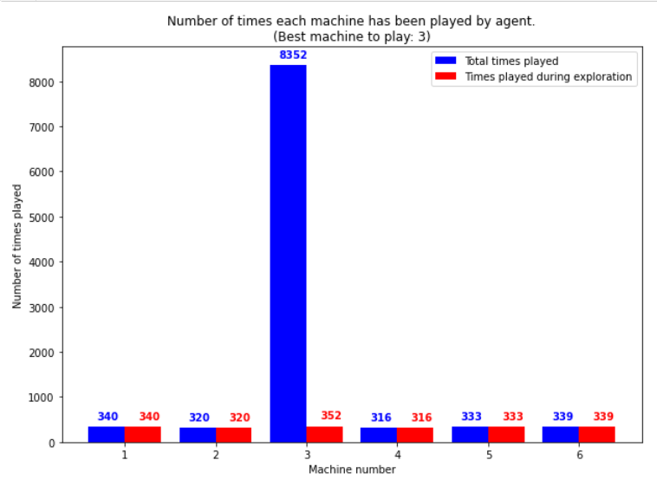
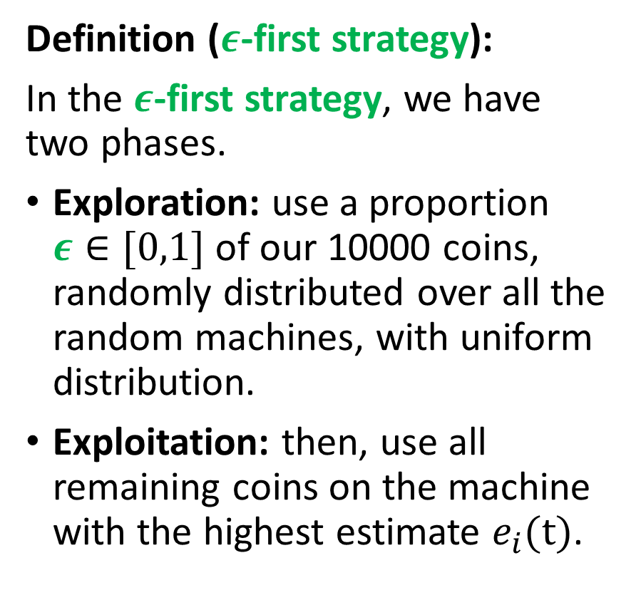
Exploring and exploiting (strategy #1)
Definition ($ε$-first strategy):
In the $ε$-first strategy, we have two phases.
Exploration: use a proportion $ε∈[0,1]$ of our 10000 coins, randomly distributed over all the random machines, with uniform distribution.
Exploitation: then, use all remaining coins on the machine with the highest estimate $e_{i}(t)$.

Slide 52
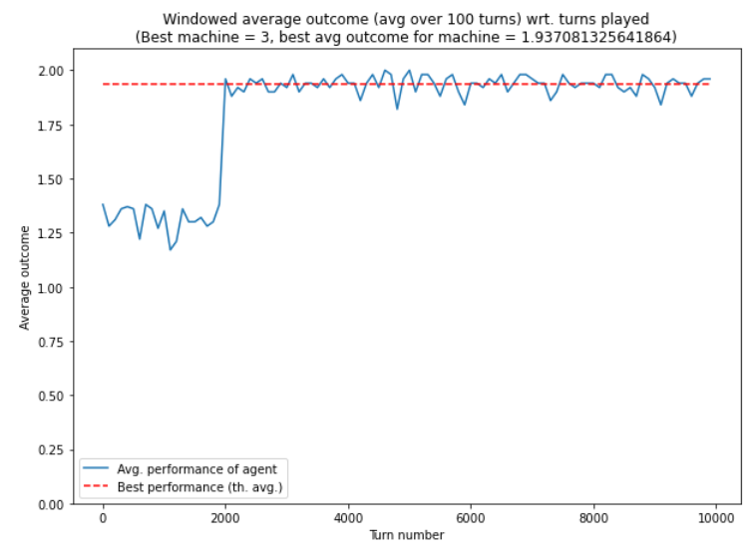
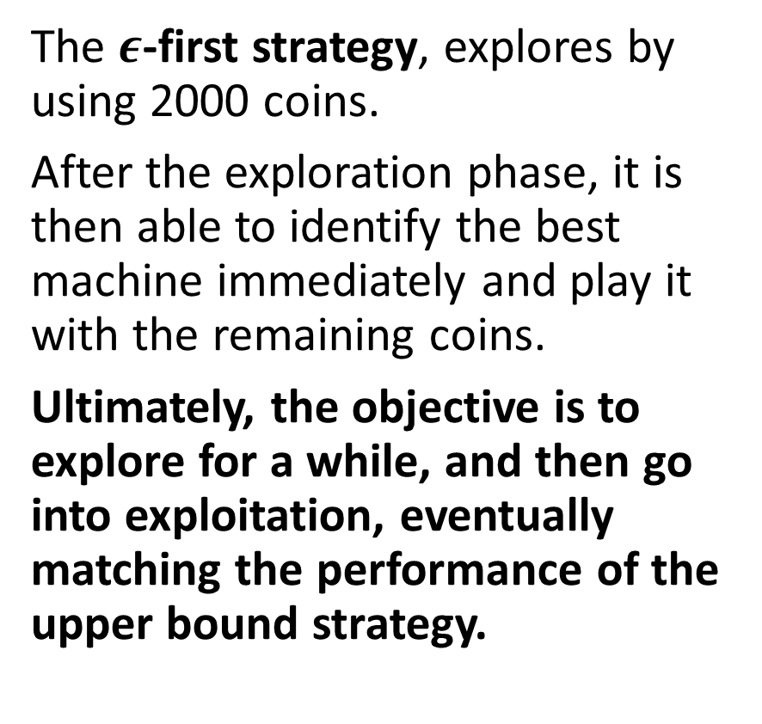
Exploring and exploiting (strategy #1)
The $ε$-first strategy, explores by using 2000 coins.
After the exploration phase, it is then able to identify the best machine immediately and play it with the remaining coins.
Ultimately, the objective is to explore for a while, and then go into exploitation, eventually matching the performance of the upper bound strategy.
Exploitation
Exploration

Slide 53
Exploring and exploiting (strategy #1)
Problem: during the exploration phase, we keep on using coins on machines, which have shown poor results.
It would be preferable to explore, by giving more coins to machines which have shown good results.
Dropping machines, which feel bad, therefore not wasting any more coins on them.

Slide 54
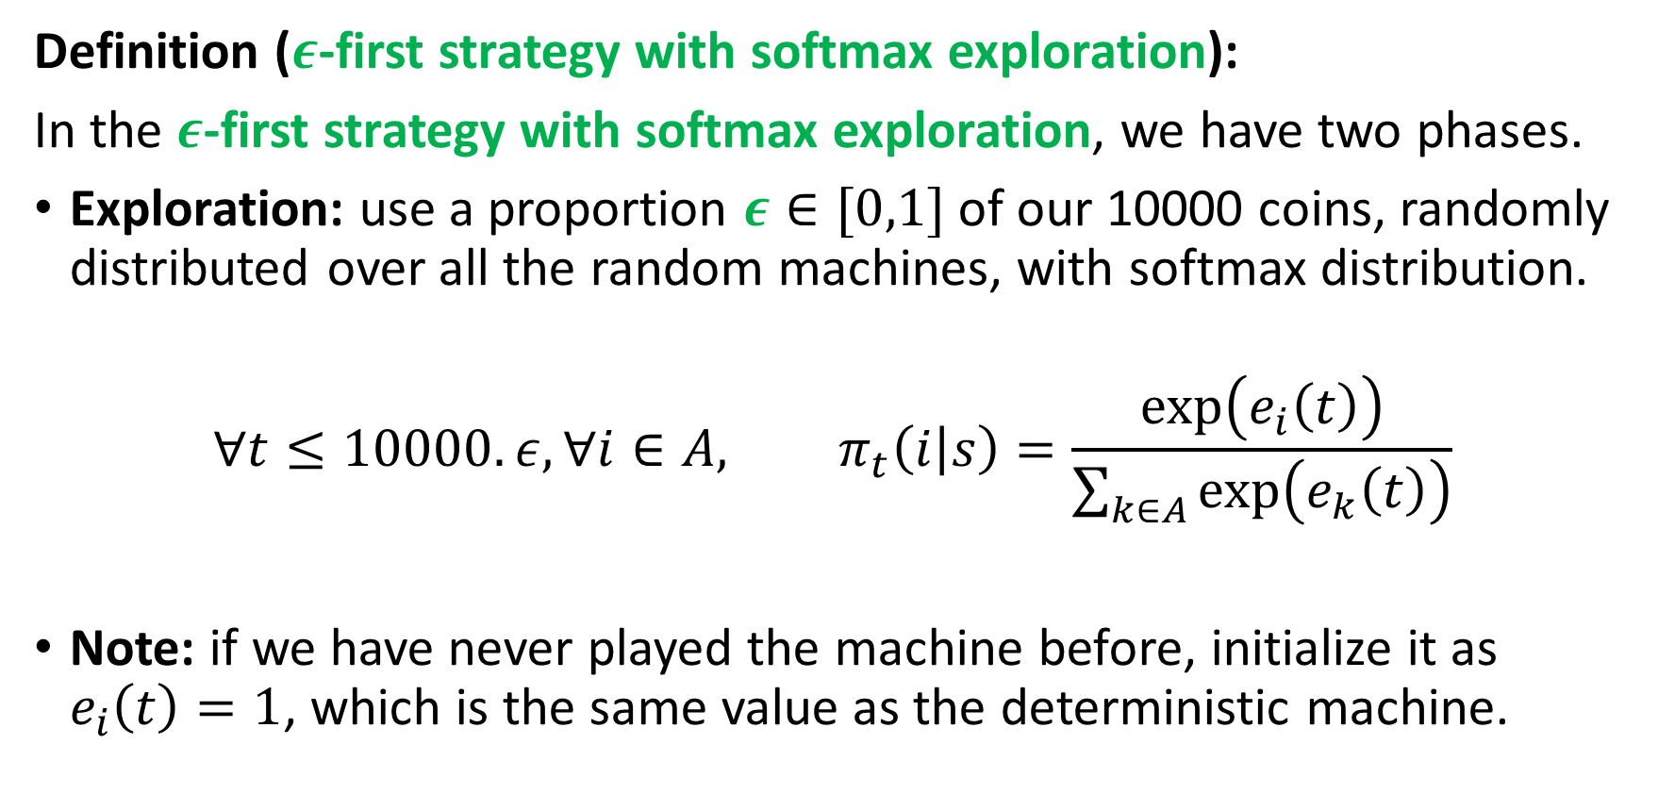
Exploring and exploiting (strategy #2)
Definition ($ε$-first strategy with softmax exploration):
In the $ε$-first strategy with softmax exploration, we have two phases.
Exploration: use a proportion $ε∈[0,1]$ of our 10000 coins, randomly distributed over all the random machines, with softmax distribution.
$$∀t≤10000.ε, ∀i∈A, π_{t}\left(i | s\right)=\frac{\exp\left(e_{i}\left(t\right)\right)}{\sum_{k∈A}{\exp\left(e_{k}\left(t\right)\right)}}$$
Note: if we have never played the machine before, initialize it as $e_{i}\left(t\right)=1$, which is the same value as the deterministic machine.

Slide 55

Exploring and exploiting (strategy #2)
Definition ($ε$-first strategy with softmax exploration):
In the $ε$-first strategy with softmax exploration, we have two phases.
Exploration: use a proportion $ε∈[0,1]$ of our 10000 coins, randomly distributed over all the random machines, with softmax distribution.
$$∀t≤10000.ε, ∀i∈A, π_{t}\left(i | s\right)=\frac{\exp\left(e_{i}\left(t\right)\right)}{\sum_{k∈A}{\exp\left(e_{k}\left(t\right)\right)}}$$
Exploitation: then, use all remaining coins on the machine with the highest estimate $e_{i}(t)$.

Slide 56
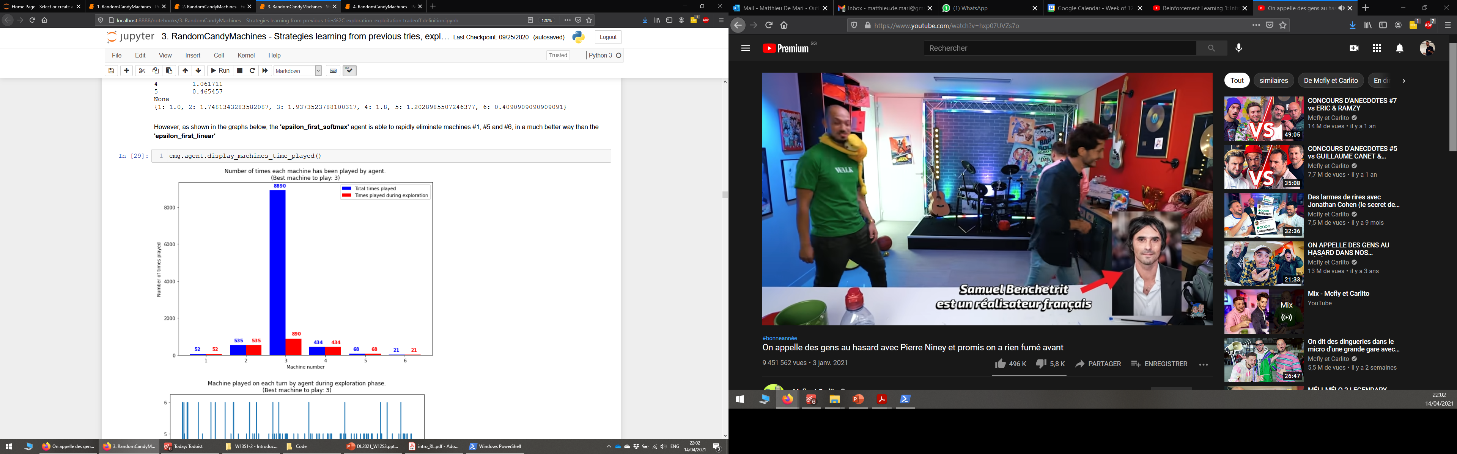


Exploring and exploiting (strategy #2)
$ε$-first strategy
$ε$-first strategy with softmax exploration

Slide 57

Exploring and exploiting (strategy #2)
Exploitation
Exploitation
Exploration
Exploration
$ε$-first strategy
$ε$-first strategy with softmax exploration

Slide 58
On regret and “cost of knowledge”
Definition (regret):
Unfortunately, we will always be wasting coins to explore, i.e. understand that some machines are bad and should not be played during the exploitation phase.
We define the regret, as the quantity of candies we have lost, during the exploration phase.
It is typically the performance difference between a given strategy and the perfect knowledge one.

Slide 59
On regret and “cost of knowledge”
Definition (“cost of knowledge”):
The regret is the number of candies we have to waste to obtain information about the hidden probabilities of the machines.
Objective: strictly equivalent to find the strategy, which minimizes regret.
The regret cannot be zero, and its minimal value could be defined as the “cost of knowledge”, i.e. what must be paid to acquire missing knowledge.

Slide 60

Some more advanced concepts and strategies
Definition (multi-armed bandit problems):
Our random candy machine problem is a well-known mathematical problem, commonly referred to as the multi-armed bandit problem.

Slide 61
Some more advanced concepts and strategies
Definition (multi-armed bandit problems):
Our random candy machine problem is a well-known mathematical problem, commonly referred to as the multi-armed bandit problem.
It consists of is a problem in which a fixed limited set of resources must be allocated between alternative choices in a way that maximizes their expected gain.
Each choice's properties are only partially known at the time of allocation, and may become better understood as time passes or by allocating resources to each possible choice.

Slide 62


Some more advanced concepts and strategies
Some advanced questions
How to decide of the value $ε$, in the $ε$-first strategies?
If $ε$ is large, waste of coins, high regret during exploration phase.
If too low, risk of missing the “best” machine, and regret will build up during exploitation phase.
So, basically, $ε$ plays the role of a hyperparameter here?

Slide 63
Some more advanced concepts and strategies
Some advanced questions
Should the length of the exploration phase be decided beforehand or on-the-fly, based on what is seen during the exploration?
If we manage to identify the “best” machine early, no point in exploring machines anymore, we should transition immediately into exploitation.
If we realize we are not confident about the “best” machine to use at the end of the fixed exploration phase, maybe better to do another round of exploration?
Or even better, smoothly transition between exploration and exploitation.

Slide 64

Exploring and exploiting (strategy #3)
Definition ($ε$-greedy strategy):
In the $ε$-greedy strategy, we define a value $ε∈[0,1]$, which decreases over time. At each time $t$, we decide on exploration/exploitation as:
$$φ_{t}=\left\{\begin{matrix}exploration & with prob. ε \\ exploitation & with prob. 1−ε\end{matrix}\right.$$
Exploration: choose action among all the random machines, with softmax distribution over the estimates $e_{i}(t)$.

Slide 65

Exploring and exploiting (strategy #3)
Definition ($ε$-greedy strategy):
In the $ε$-greedy strategy, we define a value $ε∈[0,1]$, which decreases over time. At each time $t$, we decide on exploration/exploitation as:
$$φ_{t}=\left\{\begin{matrix}exploration & with prob. ε \\ exploitation & with prob. 1−ε\end{matrix}\right.$$
Exploitation: use coin on the machine with the current highest estimate $e_{i}(t)$.

Slide 66

Exploring and exploiting (strategy #3)
Definition ($ε$-greedy strategy):
In the $ε$-greedy strategy, we define a value $ε∈[0,1]$, which decreases over time. At each time $t$, we decide on exploration/exploitation as:
$$φ_{t}=\left\{\begin{matrix}exploration & with prob. ε \\ exploitation & with prob. 1−ε\end{matrix}\right.$$
Decay on $ε$ over time: the value of $ε$ starts with 1, and progressively decays over time, progressively becoming 0.

Slide 67

Exploring and exploiting (strategy #4)
Definition (Upper Confidence Bound strategy):
In the Upper Confidence Bound strategy, we do not use the estimates of the expectation of the machine $e_{i}\left(t\right)$.
$${∀i∈A, e}_{i}(t)=\frac{\sum_{k=1}^{t}{δ_{a_{t}=i}}R_{t}}{\sum_{k=1}^{t}{δ_{a_{t}=i}}}$$

Slide 68

Exploring and exploiting (strategy #4)
Definition (Upper Confidence Bound strategy):
In the Upper Confidence Bound strategy, we do not use the estimates of the expectation of the machine $e_{i}\left(t\right)$.
Instead, we choose the machine $i$, with the highest upper bound for the confidence interval $φ_{i}$ of the statistical evaluation for machine $i$.
$$∀t, a_{t}=\arg{\max_{i∈A}\left[φ_{i}=e_{i}\left(t\right)+c\sqrt{\frac{\log\left(t\right)}{N_{t}\left(i\right)}}\right]}$$
With $c$a parameter defining the amount of exploration and $N_{t}\left(i\right)$ the amount of time we have played machine $i$, before time $t$.

Slide 69
Non-stationarity in problems
So far, we have assumed that all parameters, describing the system (e.g. the hidden probabilities of machines) were stationary.
This means that they do not change over time.
But… What if they did?
Example: machines increase their win probability when you lose and vice-versa.
→ Would then have to learn the dynamics of the probabilities (how they vary) on top of everything else!

Slide 70


Non-stationarity in problems
So far, we have assumed that all parameters, describing the system (e.g. the hidden probabilities of machines) were stationary.
This means that they do not change over time.
But… What if they did?
Example: machines increase their win probability when you lose and vice-versa.
→ Would then have to learn the dynamics of the probabilities (how they vary) on top of everything else!

Slide 71
Learn more about these topics
Out of class, for those of you who are curious
[TheBibleOfRL] R. Sutton et al., “Reinforcement learning: An Introduction, 2nd edition”, 2018.

